Slide 1
Agrobiodiversity in Agricultural Systems
Sarah Rohde Bettina Eichler-Löbermann

Slide 2
Outline
Introduction
Importance
Ecosystem Services
Plants
Livestock
Microbiota
Agricultural Systems
Society
Law
Agrobiodiversity Research & Education
Decline of Agrobiodiversity

Slide 3
Traditional vs. conventional agriculture
Notes:
Every partner should introduce here the main parts of traditional vs. Conventional agriculture in his/her country!!!

Slide 4
What is agroforestry?
Definition
A strictly scientific definition of agroforestry should stress two characteristics common to all forms of agroforestry and separate them from other forms of land use, namely:
deliberate growing of woody perennials on same unit of land as agricultural crops and/or animals, either in some form of spatial mixture or sequence
must be significant interaction (positive and/or negative) between woody and non-woody components of the system, either ecological and/or economical
Notes:
A strictly scientific definition of agroforestry should stress two characteristics common to all forms of agroforestry and separate them from the other forms of land use, namely:
the deliberate growing of woody perennials on the same unit of land as agricultural crops and/or animals, either in some form of spatial mixture or sequence
there must be a significant interaction (positive and/or negative) between the woody and non-woody components of the system, either ecological and/or economical
World Agroforestry Center (ICRAF): “Agroforestry is a collective name for land-use systems and technologies where woody perennials (trees, shrubs, palms, bamboos, etc.) are deliberately used on the same land-management units as agricultural crops and/or animals, in some form of spatial arrangement or temporal sequence. In agroforestry systems there are both ecological and economical interactions between the different components.” Agroforestry is “a dynamic, ecologically based natural resource management system that, through the integration of trees on farms and in the agricultural landscape, diversifies and sustains production for increased social, economic and environmental benefits for land-users at all levels.”

Slide 5
What is agroforestry?
World Agroforestry Center (ICRAF):
“Agroforestry is a collective name for land-use systems and technologies where woody perennials (trees, shrubs, palms, bamboos, etc.) are deliberately used on the same land-management units as agricultural crops and/or animals, in some form of spatial arrangement or temporal sequence. In agroforestry systems there are both ecological and economical interactions between the different components.”
Agroforestry is “a dynamic, ecologically based natural resource management system that, through the integration of trees on farms and in the agricultural landscape, diversifies and sustains production for increased social, economic and environmental benefits for land-users at all levels.”

Slide 6
What is agroforestry?
This definition implies that:
agroforestry normally involves two or more species of plants (or plants and animals), at least one of which is a woody perennial
an agroforestry system always has two or more outputs
the cycle of an agroforestry system is always more than one year
even the simplest agroforestry system is more complex, ecologically (structurally and functionally) and economically, than a monocropping system
In addition, it is generally accepted that agroforestry:
combines production of multiple outputs with protection of the resource base
places emphasis on the use of indigenous, multipurpose trees and shrubs
is particularly suitable for low-input conditions and fragile environments
is more concerned with socio-cultural values than most other land-use systems
Notes:
This definition implies that:
agroforestry normally involves two or more species of plants (or plants and animals), at least one of which is a woody perennial
an agroforestry system always has two or more outputs
the cycle of an agroforestry system is always more than one year
even the simplest agroforestry system is more complex, ecologically (structurally and functionally) and economically, than a monocropping system
In addition, it is generally accepted that agroforestry:
combines production of multiple outputs with protection of the resource base
places emphasis on the use of indigenous, multipurpose trees and shrubs
is particularly suitable for low-input conditions and fragile environments
is more concerned with socio-cultural values than most other land-use systems

Slide 7
What is agroforestry?
agroforestry is a new name for a set of old practices…
Simultaneous vs. sequential agroforestry systems:
Simultaneous agroforestry systems:
tree and crop components occupy same land unit at the same time
significant overlap in growth cycles of tree/crop components
Result: direct interaction between tree and crop species
include alley cropping, parklands, fodder/protein banks, live fences, boundary markings and home gardens
Sequential agroforestry systems:
trees and crops occupy same land unit at different times and interaction between them is indirect
(growth of crop and tree components occur at different times even when both components may been planted at the same time. One component species may grow rapidly, while the other grows slowly. Nutrient uptake peaks of component species may also occur in sequence, which makes species complementary in use of soil resources.)
Examples: improved fallows and rotational woodlots In sequential systems, farmer utilizes residual effects of trees
in shifting cultivation, farmers cut and burn trees and plant a new crop which depends on accumulated ash
In improved fallows, nitrogen fixing trees are deliberately planted to improve soil physical conditions and soil fertility, which benefits subsequent crops grown after harvesting trees
Notes:
It will become clear in the next section that agroforestry is a new name for a set of old practices…
Simultaneous vs. sequential agroforestry systems:
Simultaneous agroforestry systems: the tree and crop components occupy the same land unit at the same time. There is significant overlap in the growth cycles of tree/crop components. As a result there is direct interaction between tree and crop species. Simultaneous agroforestry systems include alley cropping, parklands, fodder/protein banks, live fences, boundary markings and home gardens.
Sequential agroforestry systems: trees and crops occupy the same land unit at different times and interaction between them is indirect. (The growth of the crop and the tree components occur at different times even when both components may have been planted at the same time. One component species may grow rapidly, while the other grows slowly. Nutrient uptake peaks of the component species may also occur in a sequence, which makes the species complementary in the use of soil resources.) Examples of sequential agroforestry systems are improved fallows and rotational woodlots. In sequential systems, the farmer utilizes the residual effects of the trees. Thus, in shifting cultivation the farmers cut and burn trees and then plant a new crop which depends on the accumulated ash. In improved fallows, nitrogen fixing trees are deliberately planted to improve soil physical conditions and soil fertility which benefits subsequent crops grown after harvesting the trees.

Slide 8
History of agroforestry
Agroforestry as ancient practice
story varies greatly from one place to another
practice of cultivating tree species and agricultural crops in intimate combination has existed from ancient times around the world and has constituted default practice in terms of land use management
It was only during the last centuries that farming and trees became dissociated as monocropping became more common, in an effort to intensify food production
If we go back 10,000 years we can see trees, crops, livestock and farms interacting with semi-natural vegetation, land and water, as well as budding urban markets, long before ‘forests’ were defined as an institutional entity
Notes:
Although the story varies greatly from one place to another, the practice of cultivating tree species and agricultural crops in intimate combination has existed from ancient times around the world and has constituted the default practice in terms of land use management. It was only during the last centuries that farming and trees became dissociated as monocropping became more common, in an effort to intensify food production
If we go back 10,000 years we can see trees, crops, livestock and farms interacting with semi-natural vegetation, land and water, as well as budding urban markets, long before ‘forests’ were defined as an institutional entity

Slide 9
History of agroforestry
Europe
general custom in Europe, until Middle Ages, to clear-fell derelict forest, burn slash, cultivate food crops for varying periods on cleared areas, and plant or sow trees before, along with, or after sowing agricultural crops
Northwestern Europe:
first traces of segregation of land claimed by nobility or Crown as privileged hunting grounds versus land belonging to village communities occurred over 1000 years ago.
Lines were drawn on maps with a Sylva forestis, or woodland, behind border
Forests defined as lands beyond a boundary, out of reach of village, were controlled by the elite
Magna Carta, drawn up to appease a revolt against politically weak King John in England of 1215, includes a clause that promises to ‘deforest’ land recently claimed by the Crown, returning it to be commons
importance of large trees for ships’ masts brought in navy as key stakeholder of forests
Notes:
It was the general custom in Europe, at least until the Middle Ages, to clear-fell derelict forest, burn the slash, cultivate food crops for varying periods on the cleared areas, and plant or sow trees before, along with, or after sowing the agricultural crops
Northwestern Europe: the first traces of the segregation of land claimed by nobility or the Crown as privileged hunting grounds versus land belonging to village communities occurred over 1000 years ago. Lines were drawn on maps with a Sylva forestis, or woodland, behind the border. Forests, thus defined as lands beyond a boundary, out of reach of the village, were controlled by the elite
The Magna Carta, drawn up to appease a revolt against the politically weak King John in the England of 1215, includes a clause that promises to ‘deforest’ land recently claimed by the Crown, returning it to be commons. The importance of large trees for ships’ masts brought in the navy as key stakeholder of forests.

Slide 10
Forestry developed into timber-based economic enterprise, often in conflict with villagers and their livestock
Forestry became a separate institution, foresters a separate tribe with their own cultural traditions, music and uniforms, trained in separate schools, supported by separate research institutions, laws, taxes and incentive schemes…
Providing cheap food for urban masses and industrial workforce served as justification for substantial public investment in ‘land reclamation’ schemes, reorganizing landscape and replacing fine-grained mosaics of past with a much coarser pattern.
planners might have seen three elements: agriculture, production-forest plantations and conservation (wilderness) areas but were charmed by an ‘apartheid’ thinking that favoured spatial segregation
In tropical areas, many societies have traditionally simulated forest conditions in their farms in order to obtain beneficial effects of forest structures
Notes:
Forestry developed into a timber-based economic enterprise, often in conflict with villagers and their livestock. Forestry became a separate institution, foresters a separate tribe with their own cultural traditions, music and uniforms, trained in separate schools, supported by separate research institutions, laws, taxes and incentive schemes…
Providing cheap food for the urban masses and industrial workforce served as justification for substantial public investment in ‘land reclamation’ schemes, reorganizing the landscape and replacing the fine-grained mosaics of the past with a much coarser pattern. The planners might have seen three elements: agriculture, production-forest plantations and conservation (wilderness) areas but were charmed by an ‘apartheid’ thinking that favoured spatial segregation
In tropical areas, many societies have traditionally simulated forest conditions in their farms in order to obtain the beneficial effects of forest structures

Slide 11
History of agroforestry
Central America
Farmers have long imitated structure and species diversity of tropical forests by planting a variety of crops with different growth habits
Plots of one-tenth of a hectare contained, on average, two dozen different species of plants, corresponding to layered configuration of mixed tropical forests: coconut or papaya with a lower layer of bananas or citrus, a shrub layer of coffee or cacao, tall and low annuals such as maize, and finally a spreading ground cover of plants such as squash

Slide 12
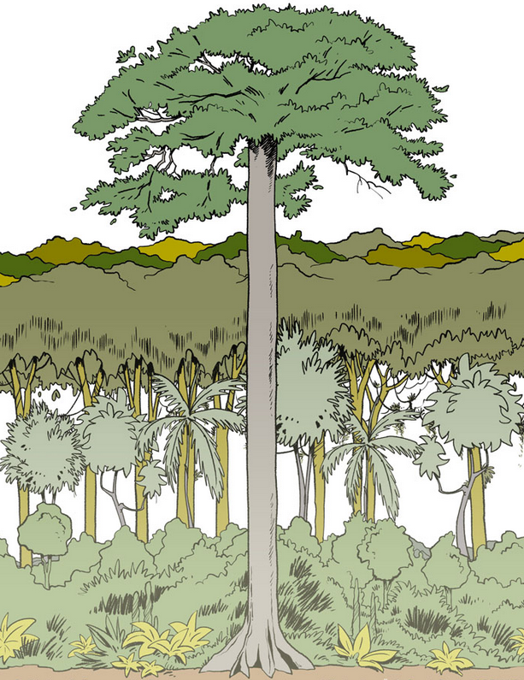
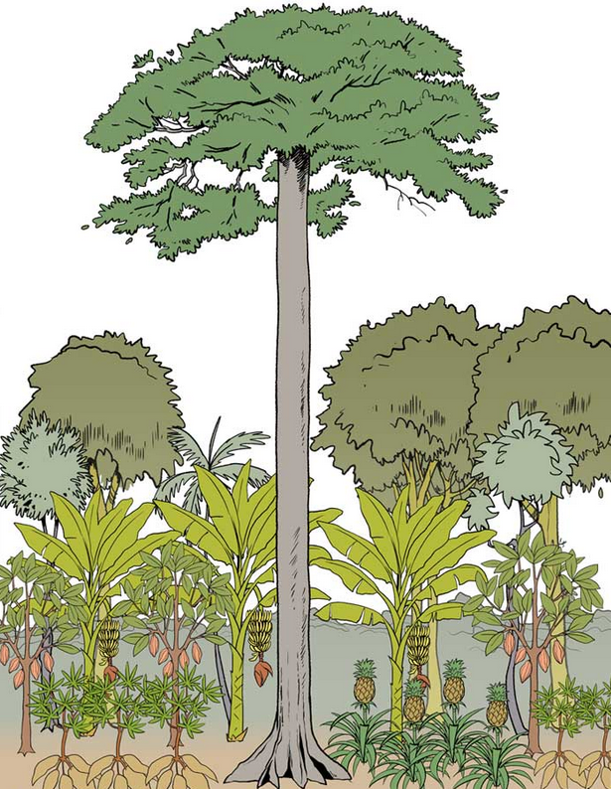
History of agroforestry
Example for a Agroforest
https://www.regenwald-schuetzen.org/regenwald-wissen/regenwaldschutz/agroforst-systeme/
Notes:
On the left:
The rain forest consists of five floors. The closer you get to the ground, the darker and wetter it gets. This thicket offers many animals and plants protection from excessive heat and prevents soil erosion, among other things.
On the right:
The jungle giants remain in the agroforest as shade providers or are replanted. Above the field crops such as pineapple, corn or legumes, shrubs and smaller trees form another layer. Cocoa, for example, is also planted here. Mangos, bananas and avocados provide shade for the cocoa.

Slide 13
History of agroforestry
Asia
E.g. the Hanunoo of the Philippines practised a complex and somewhat sophisticated type of shifting cultivation:
clearing forest for agricultural use
deliberately left certain selected trees which, by the end of rice-growing season, provide a partial canopy of new foliage to prevent excessive exposure to sun at time when moisture is more important than sunlight for the maturing grain
trees were planted or conserved from original forests to provide food, medicines, construction wood and cosmetics, addition to their protective services
Notes:
E.g. the Hanunoo of the Philippines practised a complex and somewhat sophisticated type of shifting cultivation.
In clearing the forest for agricultural use, they deliberately left certain selected trees which, by the end of the rice-growing season, would provide a partial canopy of new foliage to prevent excessive exposure to the sun at a time when moisture is more important than sunlight for the maturing grain".
Furthermore, trees were planted or conserved from the original forests to provide food, medicines, construction wood and cosmetics, in addition to their protective services

Slide 14
History of agroforestry
Africa
In Nigeria, yams, maize, pumpkins and beans typically grow together under a cover of scattered trees
e.g. for Yoruba of western Nigeria, have long practised an intensive system of mixed herbaceous, shrub and tree cropping,
system is a means of conserving human energy by making full use of limited space laboriously won from the dense forest.
They compare method to a multistoreyed building in a congested area in which expansion must be vertical rather than horizontal
Notes:
In Nigeria, yams, maize, pumpkins and beans were typically grown together under a cover of scattered trees, e.g. for the Yoruba of western Nigeria, who have long practised an intensive system of mixed herbaceous, shrub and tree cropping, the system is a means of conserving human energy by making full use of the limited space laboriously won from the dense forest. They compare the method to a multistoreyed building in a congested area in which expansion must be vertical rather than horizontal

Slide 15
History of agroforestry
Conclusion:
These examples indicate wide geographical coverage of system
clearly point to the fact that earliest practitioners of what has now become known as agroforestry perceived food production as the system's main goal.
Trees were integral part of a farming system.
deliberately kept on farmland to support agriculture.
ultimate objective was not tree production but food production!
Notes:
These examples indicate the wide geographical coverage of the system.
And they clearly point to the fact that the earliest practitioners of what has now become known as agroforestry perceived food production as the system's main goal.
Trees were an integral part of a farming system.
They were deliberately kept on farmland to support agriculture.
The ultimate objective was not tree production but food production!

Slide 16
History of agroforestry
Beginnings of ‘modern’ agroforestry
1970s, due to global problems such as increasing spread of deforestation, ecological degradation and deteriorating food situation in many areas of developing world, interest in agroforestry practices as alternative to conventional agriculture grew
term ‘agroforestry’ was coined in late 1970s, reflecting significant change in agricultural development
During this period, rural poor gained more attention from international development community
environmental and social side effects of high input agriculture induced by Green Revolution, which brought tremendous increase in yields of cereal crops, were starting to be felt
costly technologies turned out to be beyond reach of majority of resource-poor farmers in developing countries
Notes:
In the 1970s, due to global problems such as the increasing spread of deforestation, ecological degradation and the deteriorating food situation in many areas of the developing world, interest in agroforestry practices as an alternative to conventional agriculture grew
The term ‘agroforestry’ was coined in the late 1970s, reflecting a significant change in agricultural development
During this period, the rural poor gained more attention from the international development community
The environmental and social side effects of the high input agriculture induced by the Green Revolution, which brought tremendous increase in yields of cereal crops, were starting to be felt. The costly technologies turned out to be beyond the reach of the majority of resource-poor farmers in the developing countries

Slide 17
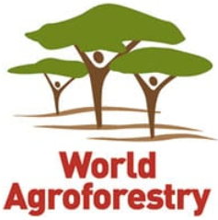
History of agroforestry
many stakeholders started to look at alternatives, such as intercropping and integrated farming, involving trees and animals
Research and funding for agroforestry practices grew:
1977 the International Council for Research in Agroforestry (ICRAF) was founded and is today called World Agroforestry Center
With increased research efforts, modern agroforestry can use science to improve already well-established local traditions
Notes:
In this context, many stakeholders started to look at alternatives, such as intercropping and integrated farming, involving trees and animals
Research and funding for agroforestry practices grew, in 1977 the International Council for Research in Agroforestry (ICRAF) was founded and is today called World Agroforestry Center
With the increased research efforts, modern agroforestry can use science to improve already well-established local traditions

Slide 18
History of agroforestry
Agroforestry today
Today agroforestry is recognized natural resource management or land-use system combining agriculture and forestry to provide increased environmental, economic and social benefits
Agroforestry is increasingly recognized as beneficial land use practice and is becoming more widespread, especially in developing and tropical countries:
government of Philippines was among the first to support agroforestry as a viable strategy for rural development
In 2014, the government of India adopted a National Agroforestry Policy
Notes:
Today agroforestry is a recognized natural resource management or land-use system combining agriculture and forestry to provide increased environmental, economic and social benefits
Agroforestry is increasingly recognized as a beneficial land use practice and is thus becoming more widespread, especially in developing and tropical countries:
The government of the Philippines was among the first to support agroforestry as a viable strategy for rural development
In 2014, the government of India adopted a National Agroforestry Policy

Slide 19
History of agroforestry
creation of modern agroforestry finds its origins in solutions to development problems
its benefits are recognized in developed countries and government support has grown accordingly:
United States: 2011-2016 Strategic Framework on Agroforestry seeks to
(1) increase use of agroforestry by landowners and communities
(2) advance the understanding of, and tools for, applying agroforestry
(3) incorporate agroforestry into an all-lands approach to conservation and economic development
Europe:
2001, tree-based intercropping systems were accepted for access to funding support from the Common Agricultural Policy (CAP) of the European Union
2004, European Commission launched Article 44 for support to agroforestry
CAP of 2014, agroforestry - solution to enhance biodiversity on farms and a means to improve forest areas and rural development
Australia and New Zealand: Landcare and Sustainable Farming Funds recognize growing trees on farms as way to gear agricultural practices towards more sustainable path, notably with agroforestry projects
Notes:
Although the creation of modern agroforestry finds its origins in the solutions to development problems, its benefits are also recognized now in developed countries, and government support has grown accordingly, e.g.:
United States: 2011-2016 Strategic Framework on Agroforestry seeks to
(1) increase use of agroforestry by landowners and communities
(2) advance the understanding of, and tools for, applying agroforestry
(3) incorporate agroforestry into an all-lands approach to conservation and economic development
Europe: In 2001, tree-based intercropping systems were accepted for access to funding support from the Common Agricultural Policy (CAP) of the European Union. In 2004, the European Commission launched Article 44 for support to agroforestry. In the CAP of 2014, agroforestry is seen as a solution to enhance biodiversity on farms and also as a means to improve forest areas and rural development
Australia and New Zealand: Landcare and the Sustainable Farming Funds recognize growing trees on farms as a way to gear agricultural practices towards a more sustainable path, notably with agroforestry projects

Slide 20
Agroforestry systems
Overview
The three main components of agroforestry…
trees, or more precisely, woody perennials (that is trees and shrubs)
crops, that is herbacious plants (agricultural/arable crops)
animals
… can be combined in numerous spatial and temporal arrangements and for different functions, creating many different kinds of systems
Notes:
The three main components of agroforestry…
trees, or more precisely, woody perennials (that is trees and shrubs)
crops, that is herbacious plants (agricultural/arable crops)
animals
… can be combined in numerous spatial and temporal arrangements and for different functions, creating many different kinds of systems

Slide 21
Agroforestry systems
Definitions taken from Nair (1993) An Introduction to Agroforestry, a reference in the field (the author, co-founder of the World Agroforestry Centre (ICRAF), is a pioneer in the establishment modern agroforestry)
Three kinds of systems:
Agrisilvicultural systems (= trees + crops)
Silvopastoral systems (= trees + pastures or animals)
Agrosilvopastoral systems (= trees + crops + animals)
Notes:
Definitions taken from Nair (1993) An Introduction to Agroforestry, a reference in the field (the author, co-founder of the World Agroforestry Centre (ICRAF), is a pioneer in the establishment modern agroforestry)
Three kinds of systems:
Agrisilvicultural systems (= trees + crops)
Silvopastoral systems (= trees + pastures or animals)
Agrosilvopastoral systems (= trees + crops + animals)

Slide 22
Agroforestry systems
Agrisilvicultural systems
Improved fallows in shifting cultivation:
woody species planted and left to grow during fallow
Taungya:
combined stand of woody and agricultural species during early stages of establishment of plantations
Alley cropping (hedgerow intercropping):
woody species in hedges, agricultural species in alleys in between hedges, microzonal or strip arrangement
Multilayer/Multispecies tree gardens:
multispecies, multilayer dense plant associations with no organized planting arrangements
Multipurpose trees on crop lands:
trees scattered haphazardly or according to some systematic patterns on terraces or plot/field boundaries
Notes:
Improved fallows in shifting cultivation:
woody species planted and left to grow during fallow
Taungya:
combined stand of woody and agricultural species during early stages of establishment of plantations.
Alley cropping (hedgerow intercropping):
woody species in hedges, agricultural species in alleys in between hedges, microzonal or strip arrangement
Multilayer/Multispecies tree gardens:
multispecies, multilayer dense plant associations with no organized planting arrangements
Multipurpose trees on crop lands:
trees scattered haphazardly or according to some systematic patterns on terraces or plot/field boundaries

Slide 23
Agroforestry systems
Plantation crop combinations:
such as integrated multistorey mixtures of plantation crops; of plantation crops in alternate; shade trees for plantation crops, shade trees scattered, intercropping
Home gardens:
multistorey combination of various trees and crops around homesteads
Trees in soil conservation and reclamation:
trees on bunds, terraces, raisers, etc. with or without grass strips; trees for soil reclamation
Shelterbelts and windbreaks, live hedges:
trees around farmland/plots
Fuelwood production:
interplanting firewood species on or around agricultural lands
Notes:
Plantation crop combinations:
such as integrated multistorey mixtures of plantation crops; of plantation crops in alternate; shade trees for plantation crops, shade trees scattered, intercropping
Home gardens:
multistorey combination of various trees and crops around homesteads
Trees in soil conservation and reclamation:
trees on bunds, terraces, raisers, etc. with or without grass strips; trees for soil reclamation
Shelterbelts and windbreaks, live hedges:
trees around farmland/plots
Fuelwood production:
interplanting firewood species on or around agricultural lands

Slide 24
Agroforestry systems
Silvopastoral systems
Trees on rangeland or pastures:
trees scattered irregularly or arranged according to some systematic pattern
Protein banks:
production of protein-rich tree fodder on farm/rangelands for cut-and-carry fodder production
Plantation crops with pastures and animals:
for example, cattle under coconuts in south-east Asia and the south Pacific
Notes:
Trees on rangeland or pastures:
trees scattered irregularly or arranged according to some systematic pattern
Protein banks:
production of protein-rich tree fodder on farm/rangelands for cut-and-carry fodder production
Plantation crops with pastures and animals:
for example, cattle under coconuts in south-east Asia and the south Pacific

Slide 25
Agroforestry systems
Agrosilvopastoral systems
Homegardens involving animals:
intimate, multistorey combination of various trees and crops, and animals, around homesteads
Multipurpose woody hedgerows:
woody hedges for browse, mulch, green manure, soil conservation, etc.
Apiculture with trees:
trees for honey production
Aquaforestry:
trees lining fish ponds, tree leaves being used as 'forage' for fish
Multipurpose woodlots:
for various purposes (wood, fodder, soil protection, soil reclamation, etc.)
Notes:
Homegardens involving animals:
intimate, multistorey combination of various trees and crops, and animals, around homesteads
Multipurpose woody hedgerows:
woody hedges for browse, mulch, green manure, soil conservation, etc.
Apiculture with trees:
trees for honey production
Aquaforestry:
trees lining fish ponds, tree leaves being used as 'forage' for fish
Multipurpose woodlots:
for various purposes (wood, fodder, soil protection, soil reclamation, etc.)

Slide 26
Agroforestry systems
Agroforestry practice
Agroforestry as a strategy for carbon sequestration, 2009, Nair, P.K.R. et al.
Tropical agroforestry | Description
Alley cropping (hedgerow intercropping) | fast-growing, preferably leguminous, woody species grown in crop fields; the woody species pruned periodically at low height (<1.0 m) to reduce shading of crops; the prunings applied as mulch into the alleys as a source of organic matter and nutrients, or used as animal fodder
Homegardens | intimate multistory combinations of a large number of various trees and crops in homesteads; livestock may or may not be present
Improved fallow | fast-growing, preferably leguminous, woody species planted and left to grow during fallow phases between cropping years for site improvement; woody species may yield economic products
Multipurpose trees (MPTs) on farms and rangelands | fruit trees and other MPTs scattered haphazardly or planted in some systematic arrangements in crop or animal production fields; trees provide fruits, fuelwood, fodder, timber, etc.
Silvopasture: Grazing systems Cut and carry system (protein banks) | integrating trees in animal production systems: cattle grazing on pasture under widely spaced or scattered trees stall-feeding of animals with high-quality fodder from trees grown in blocks on farms
Shaded perennial–crop systems | growing shade-tolerant species such as cacao and coffee under or in between overstory shade, timber, or other commercial tree crops.
Shelterbelts and windbreaks | use of trees to protect fields from wind damage, sea encroachment, floods, etc.
Taungya | growing agricultural crops during the early stages of establishment of forestry plantations
Notes:
Today, agroforestry is recognized as an integrated applied science that has the potential for addressing many of the land-management and environmental problems found in both developing and industrialized nations.
A large number of traditional as well as improved agroforestry systems has been recognized from different parts of the world.
Numerous and diverse agroforestry systems can be found in the tropics, partly because of their favorable climatic conditions and partly because of the socio-economic factors such as human-population pressure, more availability of labor, smaller land-holding size, complex land tenure, and less proximity to markets.
Lets discuss this table….

Slide 27
Agroforestry systems
Agroforestry as a strategy for carbon sequestration, 2009, Nair, P.K.R. et al.
Temperate agroforestry | Description
Alley cropping | trees planted in single or grouped rows in herbaceous (agricultural or horticultural) crops in the wide alleys between the tree rows
Forest farming | utilizing forested areas for producing specialty crops that are sold for medicinal, ornamental, or culinary uses
Riparian buffer strips | strips of perennial vegetation (tree/shrub/grass) planted between croplands/pastures and streams, lakes, wetlands, ponds, etc.
Silvopasture | combining trees with forage (pasture or hay) and livestock production
Windbreaks | row trees around farms and fields, planted and managed as part of crop or livestock operation to protect crops, animals, and soil from wind hazards
Notes:
Second part of the table…

Slide 28
Functions of agroforestry systems
Agroforestry systems perform a multitude of services
environmental
economic and
social
Notes:
Agroforestry systems perform a multitude of services
environmental
economic and
social

Slide 29
Functions of agroforestry systems
Environmental services
careful and integrated planning of agroforestry systems protects natural resources and provides many services for local, national and global community:
Protection of biodiversity:
trees create suitable environments for multitude of plants, insects and animals, agroforestry can help protect and increase local biodiversity of wild and domesticated species and varieties
Conservation of soils:
roots of trees and shrubs help to strengthen soil structure, mitigating erosion through wind and water and preventing possible landslides
Enhancement of soil fertility:
using certain trees with nitrogen-fixation functions, agroforestry can restore soil fertility using less, if any, inputs
Reclamation of degraded soils:
augmentation of tree cover on agricultural land is an efficient way to do landscape restoration without sacrificing agricultural production
Notes:
The careful and integrated planning of agroforestry systems protects natural resources and therefore provides many services for the local, national and global community:
Protection of biodiversity:
as trees create suitable environments for a multitude of plants, insects and animals, agroforestry can help protect and increase local biodiversity of wild and domesticated species and varieties
Conservation of soils:
the roots of trees and shrubs help to strengthen soil structure, thus mitigating erosion through wind and water and preventing possible landslides
Enhancement of soil fertility:
by using certain trees with nitrogen-fixation functions, agroforestry can restore soil fertility using less, if any, inputs
Reclamation of degraded soils:
the augmentation of tree cover on agricultural land is an efficient way to do landscape restoration without sacrificing agricultural production

Slide 30
Functions of agroforestry systems
Reduction of pesticide use:
providing shelter to natural enemies and making use of crops and trees' complementary pest resistance mechanisms, agroforestry reduces need for pesticides
Watershed stabilization:
capturing, filtering and storing of water resources by trees can help improve quality of water and its quantity, with potential benefits for entire watershed
Water conservation:
water conservation functions of trees and forests help prevent or fight desertification and its environmental and social consequences
Notes:
Reduction of pesticide use:
By providing shelter to natural enemies and making use of crops and trees' complementary pest resistance mechanisms, agroforestry reduces the need for pesticides
Watershed stabilization:
the capturing, filtering and storing of water resources by trees can help improve the quality of water and its quantity, with potential benefits for the entire watershed
Water conservation:
the water conservation functions of trees and forests help prevent or fight desertification and its environmental and social consequences

Slide 31
Functions of agroforestry systems
Climate change mitigation and adaptation:
integrating trees in agricultural systems can help to reduce impact of climate change on agriculture and decrease agriculture’s contribution to the phenomenon:
Sourcing wood products from on farm production decreases need to cut forest trees reducing rate of deforestation, which is one of main factors contributing to climate change
Better management of soil nutrients reduces need to resort to fertilizers another significant source of GHG emissions
Trees planted in agroforestry systems contribute to climate change mitigation through carbon sequestration
By using woodfuel from agroforestry systems, people can meet their energy needs in a carbon neutral way
Improvement of microclimates: providing shade and cooler environment to sensitive crops or animals, agroforestry can help maintain or increase yields in face of climate change, strengthening agriculture’s resilience
Notes:
Climate change mitigation and adaptation:
integrating trees in agricultural systems can help to reduce impact of climate change on agriculture and, inversely, decrease agriculture’s contribution to the phenomenon:
Sourcing wood products from on farm production decreases the need to cut forest trees, thus reducing the rate of deforestation, which is one of the main factors contributing to climate change
Better management of soil nutrients reduces the need to resort to fertilizers, another significant source of GHG emissions
Trees planted in agroforestry systems contribute to climate change mitigation through carbon sequestration
By using woodfuel from agroforestry systems, people can meet their energy needs in a carbon neutral way
Improvement of microclimates: by providing shade and a cooler environment to sensitive crops or animals, agroforestry can help maintain or increase yields in the face of climate change, strengthening agriculture’s resilience

Slide 32
Functions of agroforestry systems
Economic services:
By reducing agricultural inputs (such as fertilizers and pesticides) and production costs, or by increasing productivity, agroforestry can increase incomes
combination of trees and crops/animals enhances efficiency of land use and reduces need for fallow periods, making continuous cultivation possible and sustainable and increasing incomes
production of agricultural and forest goods with higher value, farmers and foresters can receive a better return for their labour
development of value chains for newly-produced tree products may also create new opportunities for small scale forest-based enterprises and employment
increasing diversity of production within the farming system, agroforestry can diversify income sources and reduce risk of economic failure
Notes:
By reducing agricultural inputs (such as fertilizers and pesticides) and thus production costs, or by increasing productivity, agroforestry can increase incomes
The combination of trees and crops/animals enhances the efficiency of land use and reduces the need for fallow periods, making continuous cultivation possible and sustainable and thus increasing incomes
With the production of agricultural and forest goods with higher value, farmers and foresters can receive a better return for their labour
The development of value chains for the newly-produced tree products may also create new opportunities for small scale forest-based enterprises and employment
By increasing diversity of production within the farming system, agroforestry can diversify income sources and reduce risk of economic failure

Slide 33
Functions of agroforestry systems
Combining trees with crops and/or animals helps reduce vulnerabilities and improve recovery of people after natural hazards, disasters and socioeconomic downturns
Trees and shrubs (e.g. windbreaks) help shelter animals and crops from effects of extreme weather events such as strong winds and heavy rains provide shade and cooler environment to sensitive crops or animals, agroforestry can help maintain or increase yields
diversity of trees in farmland and neighbouring natural forest fragments, supports populations of pollinator species such as insects and birds that are essential for many crops fruit tree species, that are important as human foods, rely on insect pollinators for production
recognition through incentives of environmental services provided by agroforestry can provide a new source of income for rural or urban poor
Provision of living fences for crops and fruit trees
Demarcation of boundaries
Weed control
Notes:
Combining trees with crops and/or animals helps reduce the vulnerabilities and improve the recovery of people after natural hazards, disasters and socioeconomic downturns
Trees and shrubs (e.g. windbreaks) help shelter animals and crops from the effects of extreme weather events such as strong winds and heavy rains and provide shade and a cooler environment to sensitive crops or animals, agroforestry can thus help maintain or increase yields
A diversity of trees in farmland and neighbouring natural forest fragments, where present, supports populations of pollinator species such as insects and birds that are essential for many crops. Many fruit tree species that are important as human foods rely on insect pollinators for their production
The recognition through incentives of the environmental services provided by agroforestry can provide a new source of income for the rural or urban poor
Provision of living fences for crops and fruit trees
Demarcation of boundaries
Weed control

Slide 34
Functions of agroforestry systems
Social services
Provision of food and nutrition security: particularly in developing countries, planting trees together with crops or on pasture lands can help fight hunger and malnutrition
trees are a source of food, fuel and non-wood products that can be either directly consumed/used or sold:
Growing trees which produce food (fruits, nuts, leaves, etc.) provide easy accessible nutritious food for households
trees felled or their residues can be used as wood energy for cooking and/or heating
Leaves, and other parts of trees, can serve as forage for livestock
Trees and plants grown on farms are important sources of medicines and natural remedies, which help improve people’s health
great range of lesser‐used indigenous foods found in forests and wooded lands often richer in micronutrients, fibre and protein than staple crops traditionally been harvested from forests and woodlands, access to these resources is declining
cultivation in agroforestry systems provides an alternative resource
Notes:
Provision of food and nutrition security: particularly in developing countries, planting trees together with crops or on pasture lands can help fight hunger and malnutrition, as trees are a source of food, fuel and non-wood products that can be either directly consumed/used or sold:
Growing trees which produce food (fruits, nuts, leaves, etc.) provide an easy accessible nutritious food for households
The trees felled or their residues can be used as wood energy for cooking and/or heating
Leaves, and other parts of trees, can serve as forage for livestock
Trees and plants grown on farms are important sources of medicines and natural remedies, which help improve people’s health
The great range of lesser‐used indigenous foods found in forests and wooded lands are often richer in micronutrients, fibre and protein than staple crops. Such foods have traditionally been harvested from forests and woodlands, access to these resources is declining. In this context, cultivation in agroforestry systems provides an alternative resource

Slide 35
Functions of agroforestry systems
Improvement of gender equality: women make up a significant share, and in many cases, majority, of both agricultural and forest/tree labour force. Including trees in agricultural systems can help empower women, for example:
trees are more closely accessible, women, who are often responsible for collecting of fuelwood or fodder, save precious time and energy
women frequently having a more difficult access to resources, financial or other agroforestry is low-input solution to restoring soil fertility and increasing agricultural output
selling fruits, fodder or fuelwood coming from trees on land, women can increase their access to cash
Notes:
Improvement of gender equality: women make up a significant share, and in many cases, the majority, of both the agricultural and forest/tree labour force. Including trees in agricultural systems can help empower women, for example:
When trees are more closely accessible, women, who are often responsible for the collecting of fuelwood or fodder, save precious time and energy
Because of women frequently having a more difficult access to resources, financial or other, agroforestry is a low-input solution to restoring soil fertility and increasing agricultural output
By selling fruits, fodder or fuelwood coming from trees on the land, women can increase their access to cash

Slide 36
Functions of agroforestry systems
Agroforestry systems are often part of traditional land management techniques and their maintaining holds cultural and social importance:
providing decent rural livelihoods, agroforestry can contribute to maintaining thriving rural communities and prevent migration to cities
working together with indigenous people and local communities, modern agroforestry specialists can help ensure long term sustainability of traditional systems while respecting local culture
recognition of indigenous agroforestry systems contributes to cultural diversity
Preserving indigenous working techniques and species is a way of protecting humankind’s agricultural heritage
Notes:
Agroforestry systems are often part of traditional land management techniques and, as such, their maintaining holds cultural and social importance:
By providing decent rural livelihoods, agroforestry can contribute to maintaining thriving rural communities and prevent migration to cities
By working together with indigenous people and local communities, modern agroforestry specialists can help ensure the long term sustainability of traditional systems while respecting local culture
The recognition of indigenous agroforestry systems contributes to cultural diversity
Preserving indigenous working techniques and species is a way of protecting humankind’s agricultural heritage

Slide 37
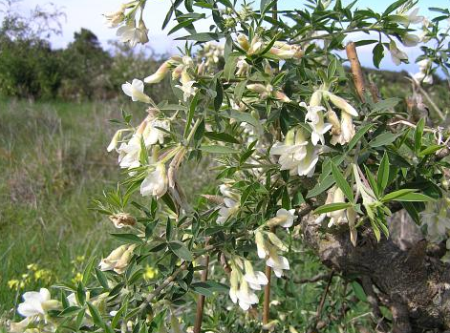
Examples of agroforestry practices
Examples from FAO (2005)
Australia:
Agroforestry systems for fodder also profitable in developed countries
northern agricultural region of western Australia, tagasaste (Chamaecytisus proliferus) planted in alley farming
plantation systems increased returns to farmers whose cattle formerly grazed on annual grasses and legumes
Chamaecytisus proliferus http://www.floradecanarias.com/chamaecytisus_proliferus.html
Notes:
Lets discuss some Examples of agroforestry practices, some are from the FAO – Food and Agricultural Organisation of the united Nations, some are from ICRAF - International Council for Research in Agroforestry/World Agroforestry Center
Australia: Agroforestry systems for fodder are also profitable in developed countries. In the northern agricultural region of western Australia, tagasaste (Chamaecytisus proliferus) planted in alley farming and plantation systems has increased returns to farmers whose cattle formerly grazed on annual grasses and legumes
Canada: Windbreaks are one of the oldest agroforestry systems in North America. In the Canadian prairies, more than 43 000 km of windbreaks have been planted since 1937, protecting 700 000 ha. Yield increase of crops sheltered from wind was estimated to be 8 percent for spring wheat, 12 percent for maize, 23 percent for winter wheat and 25 percent for barley. In addition, windbreaks improve crop water use and protect livestock and homesteads
tagasaste (Chamaecytisus proliferus)

Slide 38
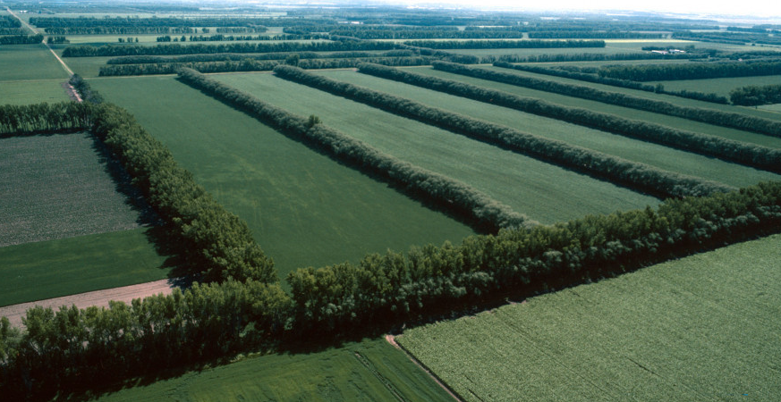
Examples of agroforestry practices
Canada:
Windbreaks one of oldest agroforestry systems in North America
Canadian prairies, more than 43 000 km of windbreaks been planted since 1937, protecting 700 000 ha
Yield increase of crops sheltered from wind - estimated to be 8 percent for spring wheat, 12 percent for maize, 23 percent for winter wheat and 25 percent for barley
windbreaks improve crop water use and protect livestock and homesteads
http://www.womenowningwoodlands.net/content/windbreaks-benefits-beyond-slowing-wind

Slide 39
Examples of agroforestry practices
China:
intercropping of trees and crops been practised on 3 million hectares in China
Farmers intercrop Paulownia spp. (primarily P. elongata) with cereals over wide expanse of North China Plain
tree is deep rooted, interferes little with crops and produces high quality timber
In Minquan County (Henan Province), 30 years after introduction of agroforestry, two-thirds of the 46 000 ha of farmland were intercropped with trees of this genus
one commune, Paulownia spp. accounted for 37 percent of farm income
In addition to timber, these species provide excellent fuelwood, leaves for fodder and compost fertilizer and protection against wind erosion and evapotranspiration
Notes:
China: intercropping of trees and crops has been practised on 3 million hectares in China. Farmers intercrop Paulownia spp. (primarily P. elongata) with cereals over a wide expanse of the North China Plain. The tree is deep rooted, interferes little with crops and produces high quality timber. In Minquan County (Henan Province), 30 years after the introduction of agroforestry, two-thirds of the 46 000 ha of farmland were intercropped with trees of this genus. In one commune, Paulownia spp. accounted for 37 percent of farm income. In addition to timber, these species provide excellent fuelwood, leaves for fodder and compost fertilizer and protection against wind erosion and evapotranspiration
Paulownia spp. (primarily P. elongata) 2 m high, one year growth

Slide 40
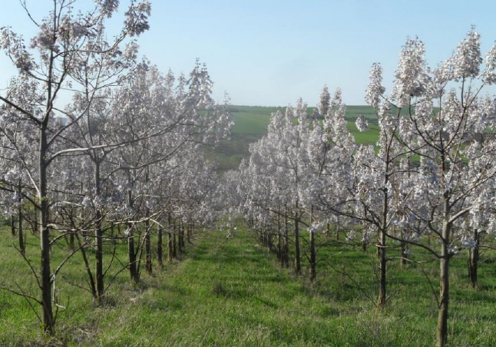
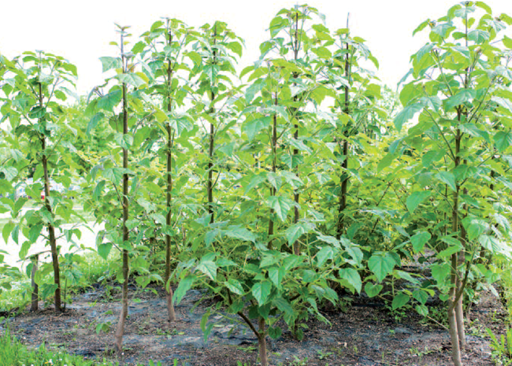
Examples of agroforestry practices
Paulownia sp, 2018, Ramona Livia Buzan et al.
Paulownia spp. (primarily P. elongata Paulownia, 2013, Bernd Stimm et al.

Slide 41
Examples of agroforestry practices
Indonesia:
areas adjacent to national parks in Sumatra, households with diversified farming systems, including mixed perennial gardens, depended much less on gathering forest products than did farms cultivating only wetland rice
tree felling and unsustainable hunting practices in nearby national parks were reduced
Notes:
Indonesia: in areas adjacent to national parks in Sumatra, households with diversified farming systems, including mixed perennial gardens, depended much less on gathering forest products than did farms cultivating only wetland rice. Thus, tree felling and unsustainable hunting practices in the nearby national parks were reduced

Slide 42
Examples of agroforestry practices
Malawi and Zambia:
planting the shrubs Tephrosia vogelii, Sesbania sesban, Gliricidia sepium or Cajanus cajan in fallows for two years, cutting them back, then following with two to three years of maize cultivation increased maize yields compared with planting continuous unfertilized maize
fertilized maize was found to perform even better than improved fallows, fallows strategy proved beneficial to farmers who could not afford fertilizer
Notes:
Malawi and Zambia: planting the shrubs Tephrosia vogelii, Sesbania sesban, Gliricidia sepium or Cajanus cajan in fallows for two years, cutting them back, then following them with two to three years of maize cultivation increased maize yields compared with planting continuous unfertilized maize. Although fertilized maize was found to perform even better than improved fallows, the fallows strategy proved beneficial to farmers who could not afford fertilizer
On the next slide, we will see the different shrubs:

Slide 43
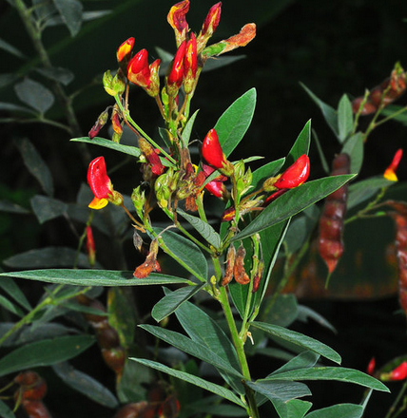
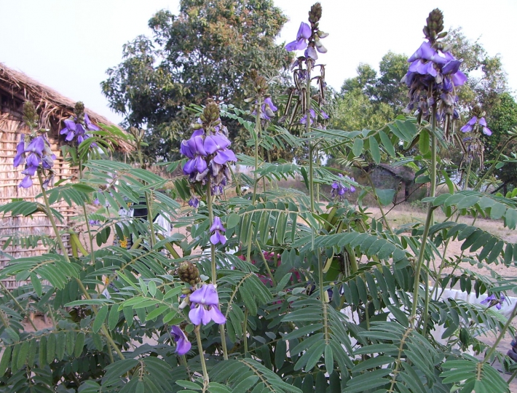
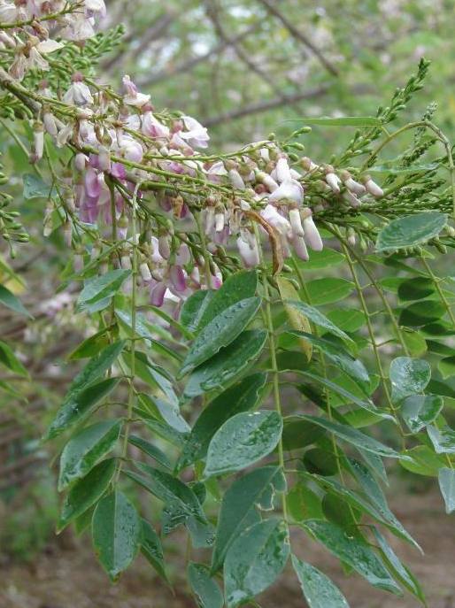
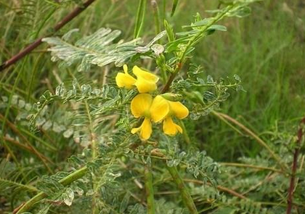
Examples of agroforestry practices
Cajanus cajan
https://www.researchgate.net/figure/Cajanus-cajan-A-flowering-branch-B-C-flowers-D-fruits-E-seeds-Cajanus-goensis_fig1_326554856
Tephrosia vogelii
http://tropical.theferns.info/image.php?id=Tephrosia+vogelii
Gliricidia sepium
https://www.biolib.cz/en/image/id54776/
Sesbania sesban
https://www.indiamart.com/proddetail/sesbania-sesban-16118741491.html
Notes:
Purpul: Tephrosia vogelii
Yellow: Sesbania sesban
Red: Cajanus cajan
Rose: Gliricidia sepium

Slide 44
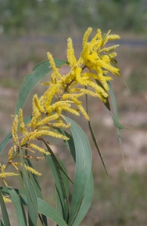
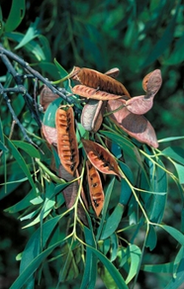
Examples of agroforestry practices
Tanzania:
in Tabora District, about 1 000 tobacco farmers have started Acacia crassicarpa woodlots to produce fuelwood for tobacco curing, intercropping trees with maize during first two years
Growing wood on farms prevents felling of trees from forest, reducing forest degradation and saving costs of transporting fuelwood
Acacia crassicarpa
http://tropical.theferns.info/viewtropical.php?id=Acacia+crassicarpa
Notes:
Tanzania: in Tabora District, about 1 000 tobacco farmers have started Acacia crassicarpa woodlots to produce fuelwood for tobacco curing, intercropping the trees with maize during the first two years. Growing wood on farms prevents the felling of trees from the forest, reducing forest degradation and saving costs of transporting fuelwood

Slide 45
Examples of agroforestry practices
Examples from FAO (2011)
Bali:
three-strata forage system combines forage crops, shrub legumes and fodder trees, food crops (maize, soybean and cassava) and livestock.
in 2000 found system reduced yield of food crops because of reductions in cropped area, forage yield was increased by 91 % and composition of livestock feed benefited from a 13 % increase in protein content
result, liveweight gains of steers increased and egg production and hatchability increased by 56 % and 22 % respectively
Soil erosion decreased by 57 % while soil organic matter content increased by 11 %
Fuelwood supply increased to meet 64 % of annual needs
project of a similar kind involving numerous farmers in India introduced trees, fodder and livestock in previously homogeneous cropping system
positive effects of diversification on soil and water retention turned an unproductive season into a productive one, resulting in sharp decrease in seasonal out-migration
Notes:
Bali: the three-strata forage system combines forage crops, shrub legumes and fodder trees, food crops (maize, soybean and cassava) and livestock. A study in the year 2000 found that although the system reduced the yield of food crops because of reductions in the cropped area, forage yield was increased by 91% and composition of livestock feed benefited from a 13% increase in protein content. As a result, liveweight gains of steers increased and egg production and hatchability increased by 56% and 22% respectively. Soil erosion decreased by 57% while soil organic matter content increased by 11%. Fuelwood supply increased to meet 64% of annual needs. A project of a similar kind involving numerous farmers in India introduced trees, fodder and livestock in a previously homogeneous cropping system; the positive effects of diversification on soil and water retention turned an unproductive season into a productive one, resulting in a sharp decrease in seasonal out-migration

Slide 46
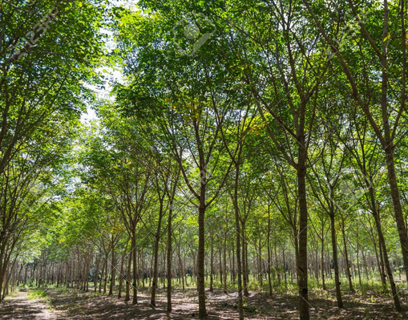
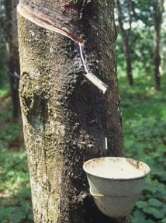
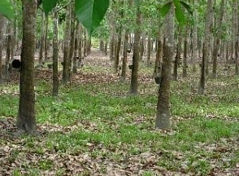
Examples of agroforestry practices
Examples from FAO (2011)
Indonesia:
agroforests with rubber trees produce a variety of other products from local biodiversity, such as durian fruits, cinnamon and timber.
These agroforestry patches, often scattered across a rice field landscape, account for 50 % – 80 % of total agricultural income of villagers in certain provinces
rubber trees
http://co2tropicaltrees.blogspot.com/2010/03/making-money-with-rubber-trees.html
https://de.123rf.com/photo_54373638_rubber-trees-in-the-row-for-rubber-tree-farm-in-thailand.html
Notes:
Indonesia: agroforests with rubber trees produce a variety of other products from local biodiversity, such as durian fruits, cinnamon and timber. These agroforestry patches, often scattered across a rice field landscape, account for 50–80% of the total agricultural income of villagers in certain provinces

Slide 47
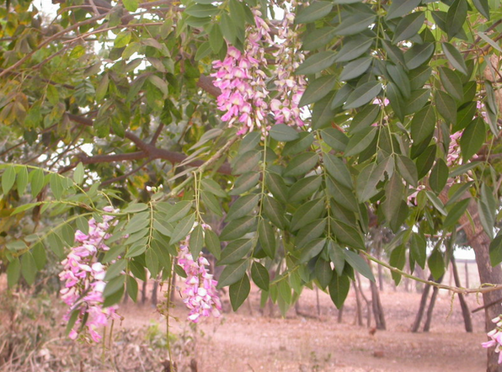
Examples of agroforestry practices
Examples from FAO (2011)
Malawi:
farmers intercropping maize with Gliricidia bushes have seen their maize yields increase threefold while also being provided with fuel for their kitchens
Gliricidia bushes
https://steemit.com/nature/@madushanka/gliricidia-sepium-is-a-plant-that-has-many-benefits
Notes:
Malawi: farmers intercropping maize with Gliricidia bushes have seen their maize yields increase threefold while also being provided with fuel for their kitchens
In 2005 they tried different shubs, they noticed probably, that Gliricidia bushes produces the best outcome of yield, so they started more planting

Slide 48
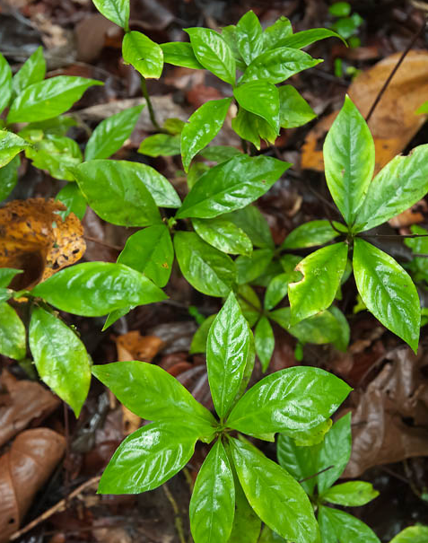
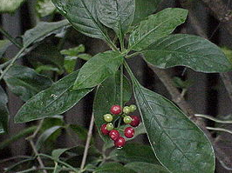
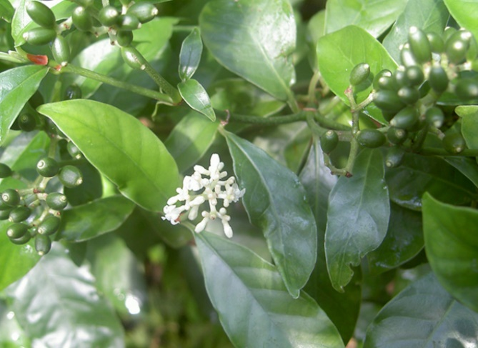
Examples of agroforestry practices
Examples from FAO (2011)
Nicaragua:
maintaining trees within fields is economically advantageous since it provides a number of products, including medicinal products from ipecac (Cephaelis ipecaucuana), fuelwood, fencing material and water regulation services
http://www.stevenfoster.com/photography/imageviewsp/psychotria/ipecacuanha/a/
https://www.earth.com/earthpedia/plant/de/carapichea-ipecacuanha/
http://www.oshims.com/herb-directory/i/ipecacuanha
Notes:
Nicaragua: maintaining trees within fields is economically advantageous since it provides a number of products, including medicinal products from ipecac (Cephaelis ipecaucuana), fuelwood, fencing material and water regulation services

Slide 49
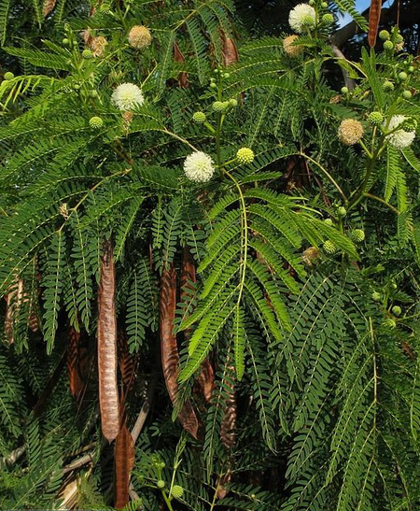
Examples of agroforestry practices
Examples from FAO (2011)
Nigeria:
a 4-year trial consistently measured greater maize yields under alley cropping with native leucaena (Leucaena leucocephala) than under conventional cropping without trees
addition of fallow periods and sheep in system further enhanced nutrient cycling process, as fallow vegetation was grazed and returned to soil as manure
https://www.etsy.com/de/listing/621554193/leucaena-leucocephala-su-babul-50-samen
Notes:
Nigeria:
a 4-year trial consistently measured greater maize yields under alley cropping with native leucaena (Leucaena leucocephala) than under conventional cropping without trees.
The addition of fallow periods and sheep in the system further enhanced the nutrient cycling process, as fallow vegetation was grazed and returned to the soil as manure

Slide 50
Examples of agroforestry practices
Examples from FAO (2011)
Sri Lanka:
upland areas, monoculture coconut systems were replaced by diversified system combining tree crops (coconut and fruits), root crops and herbs with dairy cattle, goats and poultry, with main goal of increasing farm income
integrated system was economically viable compared with coconut monoculture, with dairy production and biogas covering domestic needs and contributing most to the total profits
introduction of mixed pasture, based on easily manageable Brachiaria subquadripara and Pueraria phaseoloides and multi-purpose trees Gliricidia sepium and Leucaena leucocephala resulted in increases of 17 % and 11 % in nut and copra yield respectively
system produced enough forage to maintain animal growth and production and manure produced significantly improved soil fertility, reducing cost of fertilizing the coconuts by 69 %
Notes:
Sri Lanka: in the upland areas, monoculture coconut systems were replaced by a diversified system combining tree crops (coconut and fruits), root crops and herbs with dairy cattle, goats and poultry, with the main goal of increasing farm income. The integrated system was economically viable compared with coconut monoculture, with dairy production and biogas covering domestic needs and contributing most to the total profits. The introduction of a mixed pasture, based on easily manageable Brachiaria subquadripara and Pueraria phaseoloides and the multi-purpose trees Gliricidia sepium and Leucaena leucocephala resulted in increases of 17% and 11% in nut and copra yield respectively. The system produced enough forage to maintain animal growth and production and the manure produced significantly improved soil fertility, reducing the cost of fertilizing the coconuts by 69%

Slide 51
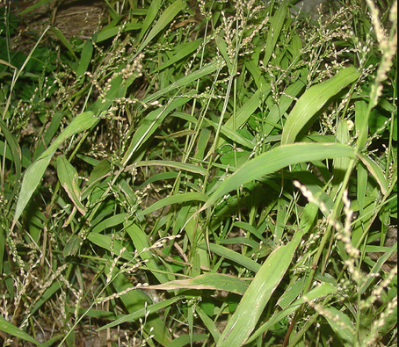
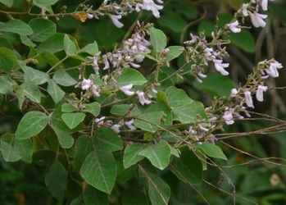
Examples of agroforestry practices
Gliricidia bushes
https://steemit.com/nature/@madushanka/gliricidia-sepium-is-a-plant-that-has-many-benefits
Brachiaria subquadripara
http://v3.boldsystems.org/index.php/Taxbrowser_Taxonpage?taxid=744583
Pueraria phaseoloides
http://tropical.theferns.info/viewtropical.php?id=Pueraria+phaseoloides
Leucaena leucocephala
https://www.etsy.com/de/listing/621554193/leucaena-leucocephala-su-babul-50-samen
Notes:
Here you see the different plants, we talked abount in the last slide

Slide 52
Examples of agroforestry practices
Examples from FAO (2011)
Coffee:
cacao and coffee are cultivated in variety of management systems ranging from shaded, multi-strata agroforests to open monocultures, the former being rich in diversity and providing beneficial ecological functions and services
Shaded coffee plantations in Ethiopia have been found to harbour 19 dominant shade tree species belonging to 14 plant families
soil is rich in arbuscular mycorrhizal fungi, especially under leguminous shade trees, and spore counts are significantly positively correlated with coffee counts and available soil phosphorus content
more open and homogeneous coffee growing systems suffer from loss of fertilization and nutrient supply services provided by shade trees and experience serious decline in pollination services, which reduces coffee yields by up to 18 % and net revenues per hectare by up to 14 % according to simulations over two decades starting from 2001
forest cover provides a compromise solution by preserving both ecological and economic values
Notes:
Next we do not talk about different country but about products, that increased through agroforestry practices
Coffee:
Important cash crops such as cacao and coffee are cultivated in a variety of management systems ranging from shaded, multi-strata agroforests to open monocultures, the former being rich in diversity and providing beneficial ecological functions and services.
Shaded coffee plantations in Ethiopia have been found to harbour 19 dominant shade tree species belonging to 14 plant families.
The soil is rich in arbuscular mycorrhizal fungi, especially under leguminous shade trees, and spore counts are significantly positively correlated with coffee counts and available soil phosphorus content.
In contrast, more open and homogeneous coffee growing systems suffer from the loss of fertilization and nutrient supply services provided by the shade trees and experience a serious decline in pollination services, which reduces coffee yields by up to 18% and net revenues per hectare by up to 14% according to simulations over two decades starting from 2001.
Establishing and maintaining a minimum threshold of forest cover provides a compromise solution by preserving both ecological and economic values.

Slide 53
Examples of agroforestry practices
Examples from FAO (2011)
More sustainable approaches to intensification of cacao systems are possible through carefully balancing trade-offs
Reduction shade tree cover from 80 % to 40 % combined with increased land-use intensity caused only minor quantitative changes in biodiversity and maintained high levels of ecosystem functioning while doubling farmers’ net income
Greater reductions in tree cover further increased short-term income gains but degraded ecosystem functions, depressing productivity in long run
Low-shade agroforestry therefore provides best available compromise between economic forces and ecological needs
Notes:
More sustainable approaches to the intensification of cacao systems are also possible through carefully balancing trade-offs.
Reduction in shade tree cover from 80% to 40% combined with increased land-use intensity caused only minor quantitative changes in biodiversity and maintained high levels of ecosystem functioning while doubling farmers’ net income.
Greater reductions in tree cover further increased short-term income gains but degraded ecosystem functions, depressing productivity in the long run.
Low-shade agroforestry therefore provides the best available compromise between economic forces and ecological needs.

Slide 54
Examples of agroforestry practices
Examples from FAO (2011)
Timber & Fuelwood:
agroforestry systems are important sources of timber and fuelwood in developing and in developed countries
For example:
intercropping of trees and crops is practised on 3 million hectares in China
In the United Kingdom, a range of timber/cereal and timber/pasture systems has been profitable to farmers
Trees produced on farm major sources of timber in Asia (e.g. China, India and Pakistan), East Africa (e.g. Tanzania) and southern Africa (e.g. Zambia)
Notes:
Timber & Fuelwood: agroforestry systems are important sources of timber and fuelwood throughout the world in both developing and developed countries. For example, intercropping of trees and crops is practised on 3 million hectares in China. In the United Kingdom, a range of timber/cereal and timber/pasture systems has been profitable to farmers. Trees produced on farm are major sources of timber in Asia (e.g. China, India and Pakistan), East Africa (e.g. Tanzania) and southern Africa (e.g. Zambia)

Slide 55
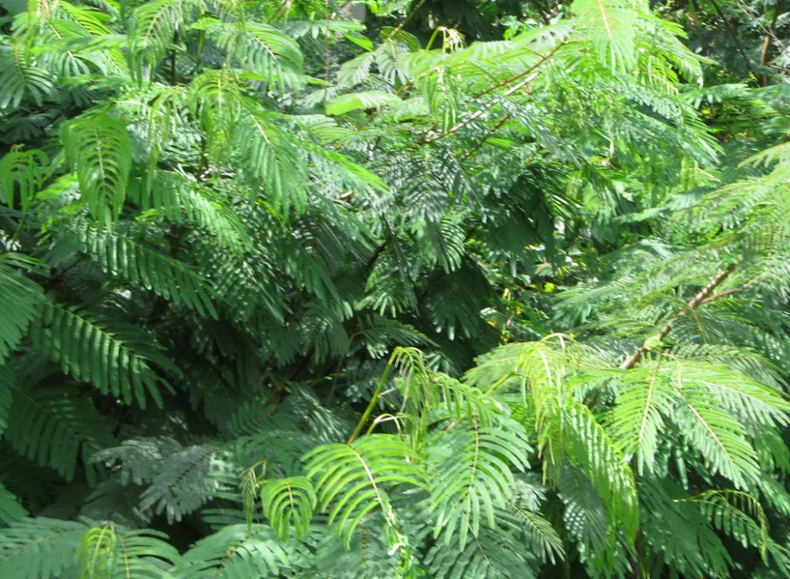
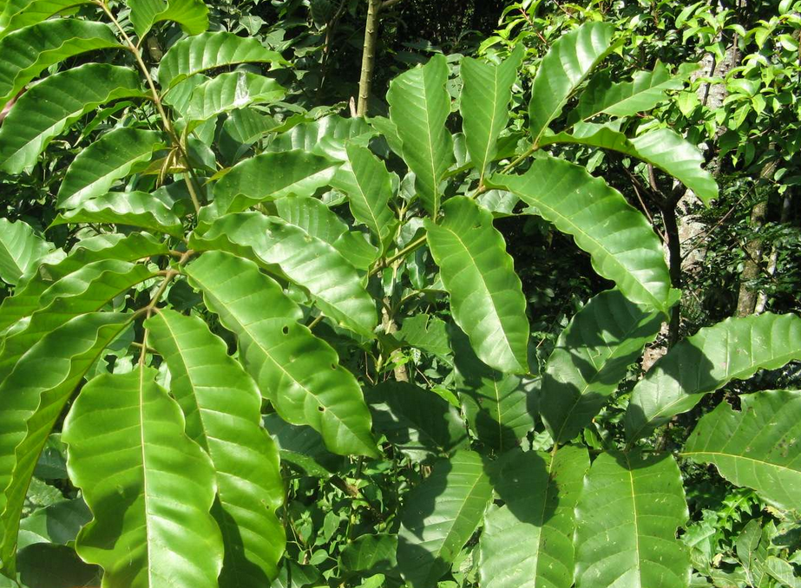
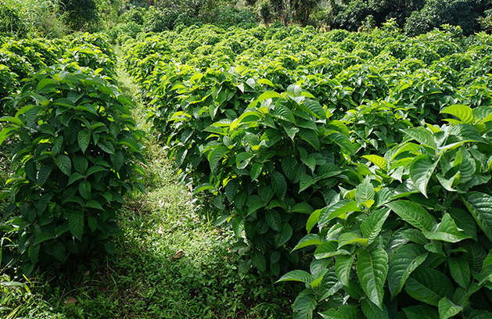
Examples of agroforestry practices
Examples from ICRAF (2013)
East Africa:
initiative, more than 200 000 smallholder dairy farmers are growing fodder shrubs as supplementary feed
typical increase in milk yield achieved by farmers is enabling to raise extra revenue from milk sales of more than US$100 per cow per year, and allowing to provide more milk to urban consumers
https://clas.berkeley.edu/research/assessment-multi-species-fodder-bank-cropping-systems-improve-farm-protein-production-food
https://sites.google.com/site/agroforestryadoptionblum/fodder-shrubs-fertiliser-trees
Notes:
East Africa: in an initiative, more than 200 000 smallholder dairy farmers are growing fodder shrubs as supplementary feed. The typical increase in milk yield achieved by farmers is enabling them to raise extra revenue from milk sales of more than US$100 per cow per year, and allowing them to provide more milk to urban consumers
Mostly used as shrubs are: Leucaena Diversifolia, Mulberry, Calliandra
Source: ICRAF (2013) Agroforestry, food and nutritional security. Background paper for the International Conference on Forests for Food Security and Nutrition, FAO, Rome, 13–15 May 2013. World Agroforestry Centre (ICRAF), Nairobi, Kenya.

Slide 56
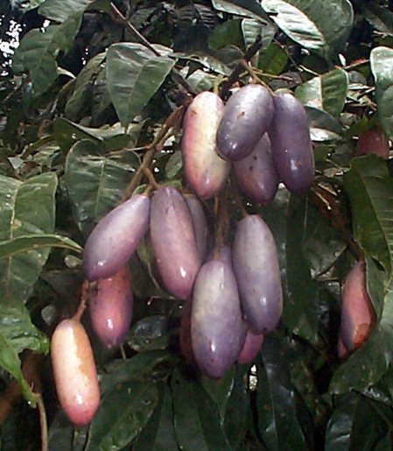
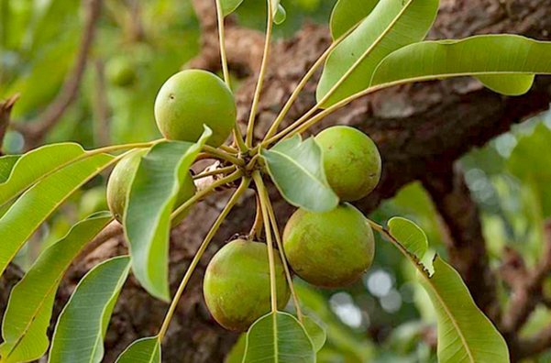
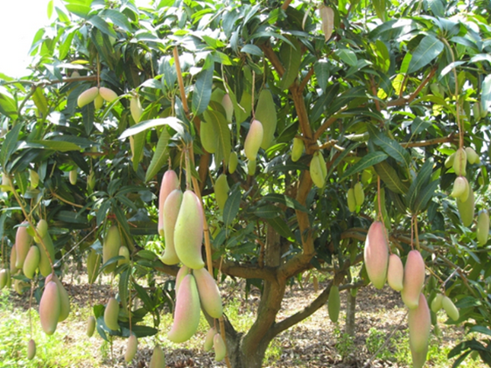
Examples of agroforestry practices
Examples from ICRAF (2013)
Africa:
support farmer incomes and food security of rural and urban populations include indigenous semi‐domesticated and widely cultivated fruit safou (Dacryodes edulis), indigenous domesticate shea nut (Vitellaria paradoxa) and exotic mango
New commercial markets for fruits are developing in Africa, result of recent investments by Coca Cola, Del Monte and others to source produce locally for juice manufacture
https://de.wikipedia.org/wiki/Dacryodes_edulis
https://desertification.wordpress.com/tag/vitellaria-paradoxa/
https://adamtropics.com/exotic-fruit-trees/qui-sequitur-mutat-detail
Notes:
Africa: examples of widely traded agroforestry tree foods that support farmer incomes and the food security of rural and urban populations include the indigenous semi‐domesticated and widely cultivated fruit safou (Dacryodes edulis), the indigenous domesticate shea nut (Vitellaria paradoxa) and exotic mango. New commercial markets for fruits are developing in Africa as a result of recent investments by Coca Cola, Del Monte and others to source produce locally for juice manufacture
From left to right:Dacryodes edulis, Vitellaria paradoxa, exotic mango
Source: ICRAF (2013) Agroforestry, food and nutritional security. Background paper for the International Conference on Forests for Food Security and Nutrition, FAO, Rome, 13–15 May 2013. World Agroforestry Centre (ICRAF), Nairobi, Kenya.

Slide 57
Examples of agroforestry practices
Examples from ICRAF (2013)
Africa:
analysis of ≥ 90 peer‐reviewed studies on soil fertility improvement
found evidence of benefits in maize yields in Africa
planting nitrogen‐fixing green fertilizers, including trees and shrubs
level of response varied by soil type and technology
increasing average yields
planting of trees as green fertilizers in southern Africa
able to stabilize crop production in drought years
during other extreme weather events
improve crop rain use efficiency
important for food security in context of climate change
is increasing drought incidence in the region
Source: ICRAF (2013) Agroforestry, food and nutritional security. Background paper for the International Conference on Forests for Food Security and Nutrition, FAO, Rome, 13–15 May 2013. World Agroforestry Centre (ICRAF), Nairobi, Kenya.
Notes:
Africa: an analysis of more than 90 peer‐reviewed studies on soil fertility improvement found consistent evidence of benefits in maize yields in Africa from planting nitrogen‐fixing green fertilizers, including trees and shrubs, although the level of response varied by soil type and technology. As well as increasing average yields, the planting of trees as green fertilizers in southern Africa is able to stabilize crop production in drought years and during other extreme weather events, and improve crop rain use efficiency (Box 2 and Figure 2). This is important for food security in the context of climate change, which is increasing drought incidence in the region

Slide 58
Examples of agroforestry practices
Examples from ICRAF (2013)
Malawi Agroforestry Food Security Programme, household food security and dietary diversity
Farmers recognized that low soil fertility is major constraint on ability to produce food
addressed this through planting of leguminous tree and shrubs
ICRAF and partners, with funding from Irish Aid, implemented Malawi Agroforestry Food Security Programme, which between 2007 and 2011 reached about 180 000 farmers
external review of programme in five districts surveyed
283 households that were beneficiaries (participants in the programme)
and 200 that were not
Source: ICRAF (2013) Agroforestry, food and nutritional security. Background paper for the International Conference on Forests for Food Security and Nutrition, FAO, Rome, 13–15 May 2013. World Agroforestry Centre (ICRAF), Nairobi, Kenya.
Source: ICRAF (2013) Agroforestry, food and nutritional security. Background paper for the International Conference on Forests for Food Security and Nutrition, FAO, Rome, 13–15 May 2013. World Agroforestry Centre (ICRAF), Nairobi, Kenya.

Slide 59
Examples of agroforestry practices
Examples from ICRAF (2013)
Malawi Agroforestry Food Security Programme, household food security and dietary diversity
four of the five districts, maize yields were higher for beneficiaries than for non‐beneficiaries
on average, beneficiaries also had more food‐secure months per year
in one district, dietary diversity (measured as number of different types of food group consumed in a day) was also higher for beneficiaries
could be attributed to greater own use of fruit trees whose management and use (of existing trees)
planting were also promoted by project, as well as increases in incomes from farm sales for food purchases
use of improved green fertiliser technologies has relevance beyond Malawi and the southern Africa region
efforts to scale up appropriate methods are underway in other parts of Africa and beyond
Source: ICRAF (2013) Agroforestry, food and nutritional security. Background paper for the International Conference on Forests for Food Security and Nutrition, FAO, Rome, 13–15 May 2013. World Agroforestry Centre (ICRAF), Nairobi, Kenya.

Slide 60
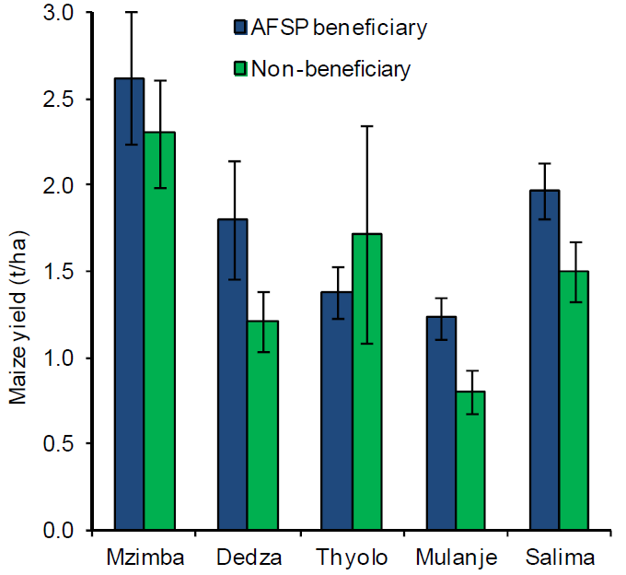
Examples of agroforestry practices
Examples from ICRAF (2013)
Maize yields in five districts in Malawi
with and without intervention of Agroforestry
Note: bars represent 95 percent confidence intervals; in three cases (Dedza, Mulanje and Salima) the difference between categories is statistically significant
Source: ICRAF (2013) Agroforestry, food and nutritional security. Background paper for the International Conference on Forests for Food Security and Nutrition, FAO, Rome, 13–15 May 2013. World Agroforestry Centre (ICRAF), Nairobi, Kenya.
Notes:
Maize yields in five districts in Malawi with and without the intervention of the Agroforestry
Food Security Programme, based on 283 beneficiaries and 200 non‐beneficiaries distributed across districts
Here you see the five districts and the yields of maize with and without Agroforestry
Farmers in Malawi have recognized that low soil fertility is a major constraint on their ability to produce food.
To address this through the planting of leguminous tree and shrubs, ICRAF and partners, with funding from Irish Aid, implemented the Malawi Agroforestry Food Security Programme,
which between 2007 and 2011 reached about 180 000 farmers.
An external review of the programme in five districts surveyed 283 households that were beneficiaries (participants in the programme) and 200 that were not.
In four of the five districts, maize yields were on average higher for beneficiaries than for non‐beneficiaries (see Figure 2); on average, beneficiaries also had more food‐secure months per year.
Except in one district, dietary diversity (measured as the number of different types of food group consumed in a day) was also higher for beneficiaries,
which could be attributed to the greater own use of fruit trees whose management and use (of existing trees)
and planting were also promoted by the project, as well as to increases in incomes from farm sales for food purchases.
The use of improved green fertiliser technologies has relevance beyond Malawi and the southern Africa region,
and efforts to scale up appropriate methods are underway in other parts of Africa
and beyond. Source: adapted from CEI (2011).

Slide 61
Examples of agroforestry practices
Source: ICRAF (2013) Agroforestry, food and nutritional security. Background paper for the International Conference on Forests for Food Security and Nutrition, FAO, Rome, 13–15 May 2013. World Agroforestry Centre (ICRAF), Nairobi, Kenya.
Examples from ICRAF (2013)
Niger:
Supporting regeneration of natural vegetation in agroforestry systems
provide significant benefits for staple crop yields
Since 1985, Farmer‐managed natural regeneration (FMNR)
encouraged in Niger by a policy shift – awarded tree tenure to farmers (as well as by more favourable wetter weather)
led to ‘re‐greening’ of approximately 5 million hectares
Cropland with: faidherbia (Faidherbia albida) and other leguminous trees in dryland agroforests (parklands)
in semiarid and sub‐humid Africa
FMNR in Sahel led to improvements in sorghum and millet yields
positive relationships have been observed with dietary diversity and household income
Notes:
Niger: Supporting the regeneration of natural vegetation in agroforestry systems can also provide significant benefits for staple crop yields.
Farmer‐managed natural regeneration (FMNR) of faidherbia (Faidherbia albida) and other leguminous trees in dryland agroforests (parklands) in semiarid and sub‐humid Africa is a good example.
Since 1985, FMNR has been encouraged in Niger by a policy shift that awarded tree tenure to farmers (as well as by more favourable wetter weather).
It has led to the ‘re‐greening’ of approximately 5 million hectares. FMNR in the Sahel has led to improvements in sorghum and millet yields, and positive relationships have been observed with dietary diversity and household income

Slide 62
Examples of agroforestry practices
Examples from ICRAF (2013)
Export crops from smallholders:
Market data recorded for agroforestry tree products are sparse, but information on export value is quantified for tree commodity crops:
palm oil (derived from oil palm, Elaeis guineensis)
coffee (primarily from Coffea arabica)
rubber (from Hevea brasiliensis)
cocoa (from cacao, Theobroma cacao)
and tea (primarily from Camellia sinensis)
Each of these is grown to a significant extent by smallholders
illustrated in Indonesia, 2011, small farms were estimated to contribute:
42 % palm oil
96 % coffee
85 % rubber
94 % cocoa
46 % tea
of the country’s total production area (Government of Indonesia, 2013)
Notes:
Export crops from smallholders:
Market data recorded for agroforestry tree products are sparse,
but information on export value is quantified for tree commodity crops
such as palm oil (derived from oil palm, Elaeis guineensis),
coffee (primarily from Coffea arabica), rubber (from Hevea brasiliensis),
cocoa (from cacao, Theobroma cacao)
and tea (primarily from Camellia sinensis).
Each of these is grown to a significant extent by smallholders, as illustrated in Indonesia, where, in 2011, small farms were estimated to contribute 42, 96, 85, 94 and 46 percent of the country’s total production area for palm oil, coffee, rubber, cocoa and tea, respectively (Government of Indonesia, 2013).
Unlike Indonesia, many countries do not formally differentiate between smallholder and plantation production, but more than two‐thirds of coffee produced worldwide is estimated to be from smallholdings (International Coffee Organization, 2013), while the figure is 90 percent for cocoa (International Cocoa Organization, 2013).
Mixed agroforestry regimes can help to avoid many of the negative effects of growing these commodity crops in monocultures, by combining tree commodities in diverse production systems with locally important food trees, staple crops, vegetables and edible fungi – such as shade coffee and shade cocoa systems – which increase or at least do not decrease commodity yields and profitability. Such systems have often been traditionally practised but are now being actively encouraged through certification and other schemes by some international purchasers of tree commodity crops.
There are also opportunities to develop valuable new tree commodities (Box 3)

Slide 63
Examples of agroforestry practices
Examples from ICRAF (2013)
Export crops from smallholders:
many countries do not formally differentiate between smallholder and plantation production
more than two‐thirds of coffee and 90 % of cocoa produced worldwide is estimated to be from smallholdings (International Coffee Organization, 2013, International Cocoa Organization, 2013)
Mixed agroforestry regimes can help to avoid many of negative effects of growing these commodity crops in monocultures
combining tree commodities in diverse production systems with locally important food trees, staple crops, vegetables and edible fungi – such as shade coffee and shade cocoa systems – which increase or at least do not decrease commodity yields and profitability
Such systems have often been traditionally practised but are now being actively encouraged through certification and other schemes by some international purchasers of tree commodity crops
opportunities to develop valuable new tree commodities
Notes:
Export crops from smallholders:
Market data recorded for agroforestry tree products are sparse,
but information on export value is quantified for tree commodity crops
such as palm oil (derived from oil palm, Elaeis guineensis),
coffee (primarily from Coffea arabica), rubber (from Hevea brasiliensis),
cocoa (from cacao, Theobroma cacao)
and tea (primarily from Camellia sinensis).
Each of these is grown to a significant extent by smallholders, as illustrated in Indonesia, where, in 2011, small farms were estimated to contribute 42, 96, 85, 94 and 46 percent of the country’s total production area for palm oil, coffee, rubber, cocoa and tea, respectively (Government of Indonesia, 2013).
Unlike Indonesia, many countries do not formally differentiate between smallholder and plantation production, but more than two‐thirds of coffee produced worldwide is estimated to be from smallholdings (International Coffee Organization, 2013), while the figure is 90 percent for cocoa (International Cocoa Organization, 2013).
Mixed agroforestry regimes can help to avoid many of the negative effects of growing these commodity crops in monocultures, by combining tree commodities in diverse production systems with locally important food trees, staple crops, vegetables and edible fungi – such as shade coffee and shade cocoa systems – which increase or at least do not decrease commodity yields and profitability. Such systems have often been traditionally practised but are now being actively encouraged through certification and other schemes by some international purchasers of tree commodity crops.
There are also opportunities to develop valuable new tree commodities (Box 3)

Slide 64
Examples of agroforestry practices
Box 3
Integrating markets and cultivation to support the sustainable development of a new tree commodity crop: the case of allanblackia
seed of allanblackia (Allanblackia spp.), found wild in humid forests of Central, East and West Africa, yield edible oil with a significant potential of more than 100 000 tonnes annually in the global food market, especially as a ‘hardstock’ for production of healthy spreads that are low in trans‐fats
private–public partnership known as Novella Africa is developing a sustainable allanblackia oil business that could be worth hundreds of millions of United States dollars annually for local farmers
A supply chain for seed has been established in Ghana, Nigeria and the United Republic of Tanzania based on harvesting by local communities in natural forests and from trees remaining in farmland after forest clearance
Currently, volumes are small (hundreds of tonnes) and oil is being exported for food product development
Notes:
Integrating markets and cultivation to support the sustainable development of a new tree commodity crop:
the case of allanblackia
The seed of allanblackia (Allanblackia spp.), found wild in the humid forests of Central, East and West Africa, yield edible oil with a significant potential of more than 100 000 tonnes annually in the global food market, especially as a ‘hardstock’ for the production of healthy spreads that are low in trans‐fats.
A private–public partnership known as Novella Africa is developing a sustainable allanblackia oil business that could be worth hundreds of millions of United States dollars annually for local farmers.
A supply chain for seed has been established in Ghana, Nigeria and the United Republic of Tanzania based on harvesting by local communities in natural forests and from trees remaining in farmland after forest clearance.
Currently, volumes are small (hundreds of tonnes) and oil is being exported for food product development.
At the same time, the tree is being brought into cultivation by improving seed handling and developing vegetative propagation methods, and through the selection of superior genotypes.
Tens of thousands of seedlings and clones have so far been distributed to smallholders.
The integration of allanblackia into small‐scale cocoa farms is being promoted to support more biodiverse and resilient agricultural landscapes.
As allanblackia trees grow, cocoa trees provide the shade they need; when they are grown, they in turn will act as shade for cocoa.
Cocoa and allanblackia provide harvests at different times of the year and – when the allanblackia trees have matured – will spread farmers’ incomes.

Slide 65
Examples of agroforestry practices
Box 3
Integrating markets and cultivation to support the sustainable development of a new tree commodity crop: the case of allanblackia
tree is being brought into cultivation by improving seed handling and developing vegetative propagation methods, and through the selection of superior genotypes
Tens of thousands of seedlings and clones have so far been distributed to smallholders
integration of allanblackia into small‐scale cocoa farms is being promoted to support more biodiverse and resilient agricultural landscapes
As allanblackia trees grow, cocoa trees provide the shade they need
when they are grown, they in turn will act as shade for cocoa
Cocoa and allanblackia provide harvests at different times of the year and – when the allanblackia trees have matured – will spread farmers’ incomes
Notes:
Integrating markets and cultivation to support the sustainable development of a new tree
commodity crop: the case of allanblackia
The seed of allanblackia (Allanblackia spp.), found wild in the humid forests of Central, East and West Africa, yield edible oil with a significant potential of more than 100 000 tonnes annually in the global food market, especially as a ‘hardstock’ for the production of healthy spreads that are low in trans‐fats.
A private–public partnership known as Novella Africa is developing a sustainable allanblackia oil business that could be worth hundreds of millions of United States dollars annually for local farmers.
A supply chain for seed has been established in Ghana, Nigeria and the United Republic of Tanzania based on harvesting by local communities in natural forests and from trees remaining in farmland after forest clearance.
Currently, volumes are small (hundreds of tonnes) and oil is being exported for food product development.
At the same time, the tree is being brought into cultivation by improving seed handling and developing vegetative propagation methods, and through the selection of superior genotypes.
Tens of thousands of seedlings and clones have so far been distributed to smallholders.
The integration of allanblackia into small‐scale cocoa farms is being promoted to support more biodiverse and resilient agricultural landscapes.
As allanblackia trees grow, cocoa trees provide the shade they need; when they are grown, they in turn will act as shade for cocoa.
Cocoa and allanblackia provide harvests at different times of the year and – when the allanblackia trees have matured – will spread farmers’ incomes.

Slide 66
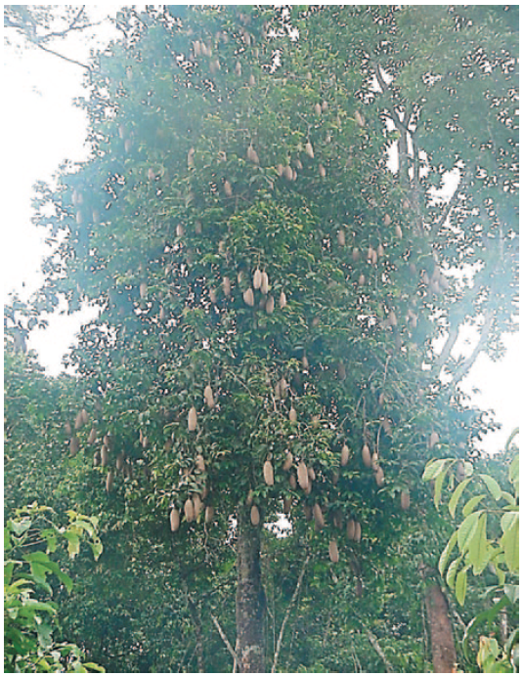
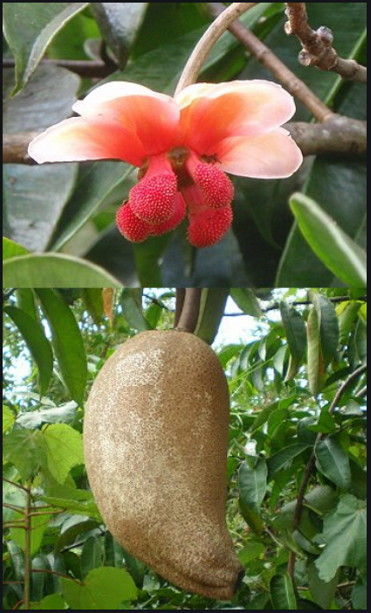
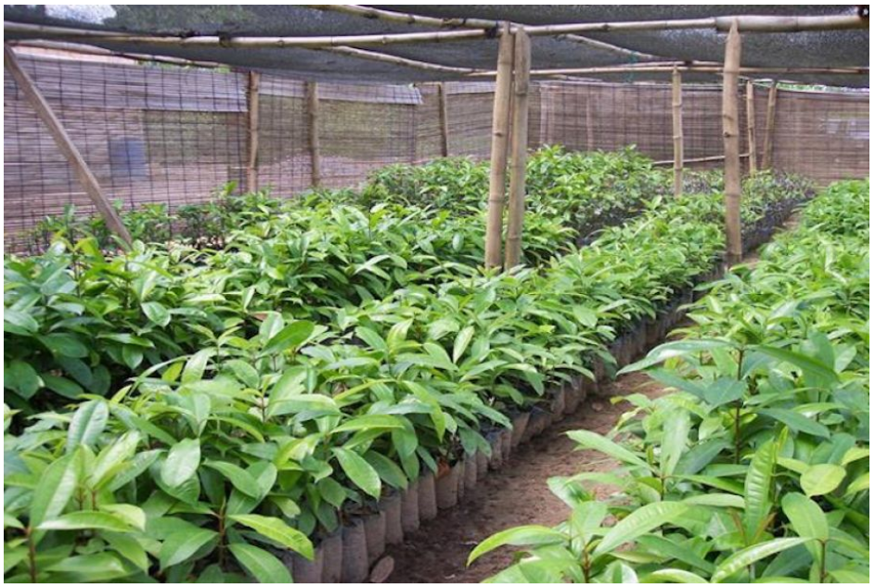
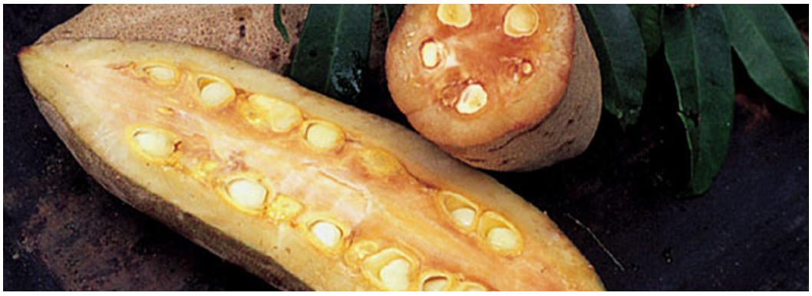
Examples of agroforestry practices
Allanblackia spp.
Tropical Agroforestry, 2014, Alain Atangana, S. 134,
https://www.valentine.gr/linkOfTheMonth-july2020.php (11.11.2020, 10:24)
https://manandnature.org/en/ingredients-en/306-allanblackia-en, 11.11.2020, 11:22 http://www.takepart.com/article/2015/12/18/african-tree-could-help-replace-palm-oil (11.11.2020, 11:24)

Slide 67
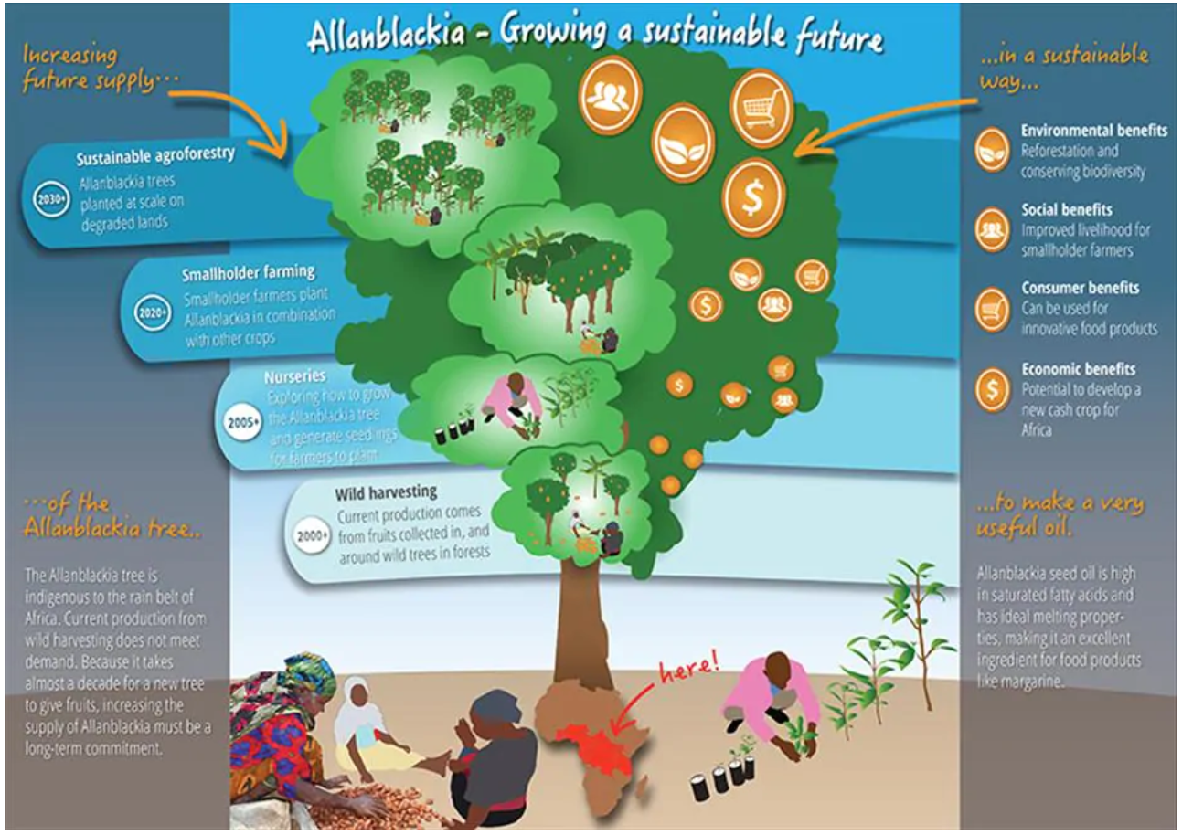
Examples of agroforestry practices
Oil from allanblackia tree offers new sources of income
https://www.unilever.com/sustainable-living/enhancing-livelihoods/inclusive-business/connecting-with-smallholder-farmers-to-enhance-livelihoods/mapping-our-farmers-programmes/tanzania.html (11.11.2020, 11:01)
Notes:
Increasind future supply…
2000 + wild harvesting – current production comes from fruits collected in, ans around wild trees in foests
2005 + Nurseries – exploring how to grow the allanblackia tree and generate seedlings for farmers to plant
2020 + Smallholder farming – Smallholder farmers plant Allanblackia in combination with other crops
2030 + Sustainable agroforestry – allanblackia frees planted at scale on degraded lands
… in a stainable way…
Environmental Benefits – Reforestation and conservong biodiversity
Social benefits – Improved lievelihood for smallholder farners
Consumer benefits – Can be used for innovative food products
Economic Benefits – Potential to develop a new cash crop for Africa
… Of the allanblackia tree…
The alanblackia tree is indigenous to the rain belt of africa. Current production from wild harvesting does not meet demand. Because it takes almost a decade fo a new tree to give fruits, increasing the supply of Allanblackia mustbe a long-term commitment.
… to make a very useful oil.
Allanblackia seed oil is high in saturated fatty acids and has ideal melting properties, making it an exellent ingredient for food products like margarine.

Slide 68
Challenges for agroforestry – OR – Why not to practice agroforestry
Policy constraints
First, policies regarding land tenure:
Land tenure rights are particularly important for agroforestry compared with other agricultural practices
because of the relatively long period that may be required to realise benefits
Sometimes, policies on ownership have perverse effects
for example when regulations designed to control the harvesting, cutting or sale of tree products from forests are applied to farmland and limit the ability to use planted trees as substitutes for a wild resource
Second, policies that determine how farmers obtain seeds, seedlings and clones of a wide range of tree species suitable for their various planting requirements:
current policies often slow the adoption of agroforestry
Third, the current policy environment often does not recognize agroforestry options as an attractive investment area in agriculture:
e.g. governments often subsidize the provision of artificial fertilizers to enhance staple crop yields.
This however, discourages the adoption of improved fallow technologies that could ultimately increase staple crop production more cost effectively and sustainably
Notes:
First, policies regarding land tenure:
Land tenure rights are particularly important for agroforestry compared with other agricultural practices
because of the relatively long period that may be required to realise benefits.
Sometimes, policies on ownership have perverse effects,
for example when regulations designed to control the harvesting, cutting or sale of tree products from forests are applied to farmland and limit the ability to use planted trees as substitutes for a wild resource
Second, policies that determine how farmers obtain seeds, seedlings and clones of a wide range of tree species suitable for their various planting requirements:
current policies often slow the adoption of agroforestry
Third, the current policy environment often does not recognize agroforestry options as an attractive investment area in agriculture:
e.g. governments often subsidize the provision of artificial fertilizers to enhance staple crop yields.
This however, discourages the adoption of improved fallow technologies that could ultimately increase staple crop production more cost effectively and sustainably

Slide 69
Challenges for agroforestry – OR – Why not to practice agroforestry
Market constraints
For many tree products, markets are poorly structured and coordinated
This results in low and unstable returns to farmers and high prices for buyers of tree foods
which limits their consumption
Notes:
For many tree products, markets are poorly structured and coordinated.
This results in low and unstable returns to farmers and high prices for buyers of tree foods, which limits their consumption

Slide 70
Challenges for agroforestry – OR – Why not to practice agroforestry
Lack of research
underinvestment in development of new tree lines, cultivars, etc.
that have high yields and provide quality products under smallholder production conditions
Until recently, for example, scientists mostly ignored the great potential for the improvement of indigenous fruit trees
There are insufficient numbers of scientists working on bringing these indigenous species into cultivation in the tropics
Notes:
There has been underinvestment in the development of new tree lines, cultivars, etc., that have high yields and provide quality products under smallholder production conditions.
Until recently, for example, scientists mostly ignored the great potential for the improvement of indigenous fruit trees.
There are insufficient numbers of scientists working on bringing these indigenous species into cultivation in the tropics.

Slide 71
Challenges for agroforestry – OR – Why not to practice agroforestry
Nordwijk (2014): Farmers reasons for not having trees on their farms
Farmers “don’t like trees on their farms because…
…they don’t want to be caught for illegal logging if they cut some of them for direct use, or for income if they have to capitalize their savings that grow with interest rates higher than banks.
…Or they don’t like trees because they can’t get the types and varieties of trees that would do well on their farms.
…Or they don’t like trees because they live too far from the market to sell the fruit and no middlemen visit them at harvest season.
…Or they don’t like trees because they fear their agroforest will be mistaken for a forest and be claimed by the forestry department, as has happened in parts of Indonesia.
…Or they respect local rules that forbid farmers to plant trees because those trees would establish private claims to land.
…Or they don’t plant trees on the land they till because tree ownership is restricted to men.”
Notes:
Farmers “don’t like trees on their farms because…
…they don’t want to be caught for illegal logging if they cut some of them for direct use, or for income if they have to capitalize their savings that grow with interest rates higher than banks.
…Or they don’t like trees because they can’t get the types and varieties of trees that would do well on their farms.
…Or they don’t like trees because they live too far from the market to sell the fruit and no middlemen visit them at harvest season.
…Or they don’t like trees because they fear their agroforest will be mistaken for a forest and be claimed by the forestry department, as has happened in parts of Indonesia.
…Or they respect local rules that forbid farmers to plant trees because those trees would establish private claims to land.
…Or they don’t plant trees on the land they till because tree ownership is restricted to men.”

Slide 72
Challenges for agroforestry – OR – Why not to practice agroforestry
Jacobson & Car (2013): Obstacles to agroforestry adoption in the USA
in the order of importance as stated by farmers:
Lack of developed markets for products
Unfamiliar with technologies
Have not seen agroforestry successfully used
Competition between trees, crops, and animals
Lack of financial assistance
Does not show much profit potential
Lack of demonstration sites
Expense of additional management
Lack of training or expertise
Notes:
in the order of importance as stated by farmers:
Lack of developed markets for products
Unfamiliar with technologies
Have not seen agroforestry successfully used
Competition between trees, crops, and animals
Lack of financial assistance
Does not show much profit potential
Lack of demonstration sites
Expense of additional management
Lack of training or expertise

Slide 73
Challenges for agroforestry – OR – Why not to practice agroforestry
Jacobson & Car (2013): Obstacles to agroforestry adoption in the USA
in the order of importance as stated by farmers:
Do not know where to market products
Lack of technical assistance
It will be too time consuming
Cannot afford adoption or start up costs
Unfamiliar with alternative marketing approaches (e.g. web)
Information about agroforestry unavailable
It is inconvenient
Do not have infrastructure (e.g. buildings, equipment)
Lack of equipment
Insufficient land
Lack of seed/seedling resources
Notes:
in the order of importance as stated by farmers:
Do not know where to market products
Lack of technical assistance
It will be too time consuming
Cannot afford adoption or start up costs
Unfamiliar with alternative marketing approaches (e.g. web)
Information about agroforestry unavailable
It is inconvenient
Do not have infrastructure (e.g. buildings, equipment)
Lack of equipment
Insufficient land
Lack of seed/seedling resources

Slide 74
Pro vs. Contra
Benefits for farmers
There are many reasons why the management of agroforestry systems can make sense for farmers:
Provision of highly demanded woody bioenergy sources on agricultural land
Expansion of the agricultural product range (product diversification)
Improvement of the income function (especially at low-income locations)
Improved area-based energy balance and improved nutrient use efficiency
Positive yield effects and higher yield stability for annual crops due to an improved microclimate (e.g. through wind protection of the tree strips)
Better seasonal distribution of work peaks (management of woody plants mainly in winter)
Improved protection of arable crops against adverse weather conditions
Reduction of the area-related consumption of fertilisers and pesticides
Notes:
Benefits for farmers There are many reasons why the management of agroforestry systems can make sense for farmers. Provision of highly demanded woody bioenergy sources on agricultural land
Expansion of the agricultural product range (product diversification)
Improvement of the income function (especially at low-income locations)
Improved area-based energy balance and improved nutrient use efficiency
Positive yield effects and higher yield stability for annual crops due to an improved microclimate (e.g. through wind protection of the tree strips)
Better seasonal distribution of work peaks (management of woody plants mainly in winter)
Improved protection of arable crops against adverse weather conditions
Reduction of the area-related consumption of fertilisers and pesticides

Slide 75
Pro vs. Contra
Advantages for municipalities
What benefits does agroforestry have for communities?
Creation of regional markets for agroforestry products and processing
enrichment and aesthetic enhancement of the landscape with positive effects on tourism and quality of life
Development of sustainable agricultural structures
Strengthening rural regions by promoting regional material cycles and regional value creation
Sustainable energy supply
Improved groundwater quality
Notes:
Advantages for municipalities
What benefits does agroforestry have for communities?
Creation of regional markets for agroforestry products and processing
enrichment and aesthetic enhancement of the landscape with positive effects on tourism and quality of life
Development of sustainable agricultural structures
Strengthening rural regions by promoting regional material cycles and regional value creation
Sustainable energy supply
Improved groundwater quality

Slide 76
Pro vs. Contra
Advantages for landowners
Landowners can also benefit from agroforestry systems:
Reduction of soil erosion by wind and water
Reduction of substance discharge from agricultural land into ground and surface waters
Increase of soil fertility through more closed nutrient cycles and humus enrichment
Notes:
Advantages for landowners
Landowners can also benefit from agroforestry systems.
Reduction of soil erosion by wind and water
Reduction of substance discharge from agricultural land into ground and surface waters
Increase of soil fertility through more closed nutrient cycles and humus enrichment

Slide 77
Pro vs. Contra
Benefits for environmental and nature conservation
How can environmental and nature conservation benefit from agroforestry systems?
Increasing structural and habitat diversity in agriculturally influenced regions Woody structures and fringe areas in agroforestry systems represent a valuable habitat for numerous plant and animal species
Increasing biodiversity
Promotion of beneficial organisms in the arable area
Creation of quiet or extensive zones in agricultural areas
Creation of retreat areas for game (especially small game)
Extensification of agricultural production
Sustainable provision of woody energy raw materials
Notes:
Benefits for environmental and nature conservation
How can environmental and nature conservation benefit from agroforestry systems?
Increasing structural and habitat diversity in agriculturally influenced regions. Woody structures and fringe areas in agroforestry systems represent a valuable habitat for numerous plant and animal species.
Increasing biodiversity
Promotion of beneficial organisms in the arable area
Creation of quiet or extensive zones in agricultural areas
Creation of retreat areas for game (especially small game)
Extensification of agricultural production
Sustainable provision of woody energy raw materials

Slide 78
Pro vs. Contra
Disadvantages of agroforestry
What restrictions result from agroforestry?
Higher establishment costs of agroforestry systems in comparison to annual crops
Increased effort and higher management costs
Long-term capital and area commitment due to the comparatively slow growing trees and shrubs
In special cases: Woody roots can penetrate existing field drainage systems and destroy/clog them
Competition between woody plants and arable crops for light, nutrients, water and growing space with negative effects on plant growth
However, careful planning prior to the establishment of the area and professional establishment and management of agroforestry systems can generally avoid the majority of the negative effects mentioned or at least reduce them to a tolerable level
Notes:
Disadvantages of agroforestry
What restrictions result from agroforestry?
Higher establishment costs of agroforestry systems in comparison to annual crops
Increased effort and higher management costs
Long-term capital and area commitment due to the comparatively slow growing trees and shrubs
In special cases: Woody roots can penetrate existing field drainage systems and destroy/clog them
Competition between woody plants and arable crops for light, nutrients, water and growing space with negative effects on plant growth
However, careful planning prior to the establishment of the area and professional establishment and management of agroforestry systems can generally avoid the majority of the negative effects mentioned or at least reduce them to a tolerable level.

Slide 79
Success factors
factors contribute to successful adoption and practice of agroforestry
Secure land tenure and sensible government regulations
Farmers with insecure land rights are unable or unwilling to plant tree
In many countries, bans on cutting down trees are a disincentive for farmers to plant them
Therefore, mechanisms are needed to exempt trees on farms from such ordinances
Adaptation to local conditions
Agroforestry systems and technologies need to be adapted:
to local environmental, economic and social conditions
Successful efforts to introduce agroforestry often combine modern science and local traditional knowledge
Availability of information and training
Farmers need more information and training for agroforestry relative to other agricultural activities
When starting operations, they often lack skills to establish tree and shrub nurseries, pre-treat the seeds and carry out tree pruning activities
(FAO (2005))
Notes:
Secure land tenure and sensible government regulations
Farmers with insecure land rights are unable or unwilling to plant tree
In many countries, bans on cutting down trees are a disincentive for farmers to plant them.
Therefore, mechanisms are needed to exempt trees on farms from such ordinances
Adaptation to local conditions
Agroforestry systems and technologies need to be adapted to local environmental, economic and social conditions
Successful efforts to introduce agroforestry often combine modern science and local traditional knowledge
Availability of information and training
Farmers need more information and training for agroforestry relative to other agricultural activities
When starting operations, they often lack skills to establish tree and shrub nurseries, pre-treat the seeds and carry out tree pruning activities

Slide 80
Success factors
factors contribute to successful adoption and practice of agroforestry
Government and project support
needed to promote tree planting,
provide information and technical assistance
fill other gaps such as supplying tree seeds where they are not available
Lack of financial credit is not a major constraint to adopting agroforestry practices because of the small size of farms and scale of operations
the incremental approach that farmers use to plant trees and the desire of most farmers to avoid risks
In many instances, offering free inputs or paying farmers to plant trees encourages dependency and acts as a disincentive to planting when a project ends
In most cases, credit or payments to farmers for planting trees are not required and may do more harm than good
Once farmers start planting on a small scale and see benefits, they are usually able and willing to continue
Notes:
Government and project support
Government and project interventions are needed to promote tree planting, provide information and technical assistance and fill other gaps such as supplying tree seeds where they are not available
Lack of financial credit is not a major constraint to adopting agroforestry practices because of the small size of farms and scale of operations, the incremental approach that farmers use to plant trees and the desire of most farmers to avoid risks
In many instances, offering free inputs or paying farmers to plant trees encourages dependency and acts as a disincentive to planting when a project ends.
In most cases, credit or payments to farmers for planting trees are not required and may do more harm than good
Once farmers start planting on a small scale and see the benefits, they are usually able and willing to continue

Slide 81
Success factors
factors contribute to successful adoption and practice of agroforestry
Access to markets
Assessing demand before planting trees is a critical first step in adopting agroforestry
advantageous to link farmers to local markets:
assist farmers to sell their produce locally before they attempt to enter a more competitive export market
training in entrepreneurship and business skills has proven highly beneficial to farmers
farmer organizations can have an important role in assembling produce, bargaining collectively and reducing transaction costs
Decentralized germplasm strategies
most successful approaches to supplying and distributing planting material are those involving community-based seed stands and nurseries managed by individual farmers or groups
Seed and nursery enterprises can also help to increase incomes
Efforts are needed to ensure the quality and diversity of planting material
Notes:
Access to markets
Assessing demand before planting trees is a critical first step in adopting agroforestry
It is also advantageous to link farmers to local markets, i.e. assist farmers to sell their produce locally before they attempt to enter a more competitive export market
In addition, training in entrepreneurship and business skills has proven highly beneficial to farmers, and farmer organizations can have an important role in assembling produce, bargaining collectively and reducing transaction costs
Decentralized germplasm strategies
The most successful approaches to supplying and distributing planting material are those involving community-based seed stands and nurseries managed by individual farmers or groups. Seed and nursery enterprises can also help to increase incomes. Efforts are needed to ensure the quality and diversity of planting material

Slide 82
Summary
Traditional vs. conventional agriculture
What is agroforestry?
History of agroforestry
Agroforestry systems
Functions of agroforestry systems
Examples of agroforestry practices
Challenges for agroforestry – OR – Why not to practice agroforestry
Pro vs. Contra
Success factors

Slide 83
Further reading
FAO (2005) Realizing the economic benefits of agroforestry: experiences, lessons and challenges. In: State of the World’s Forests. Food and Agriculture Organization of the United Nations, Rome, Italy.
FAO (2011) Biodiversity for Food and Agriculture: Contributing to food security and sustainability in a changing world. Food and Agriculture Organization of the United Nations & Platform for Agrobiodiversity Research, Rome, Italy.
ICRAF (2013) / Dawson, I.K., Place, F., Torquebiau, E., Malézieux, E., Iiyama, M., Sileshi, G.W., Kehlenbeck, K., Masters, E., McMullin, S., Jamnadass, R. (2013) Agroforestry, food and nutritional security. Background paper for the International Conference on Forests for Food Security and Nutrition, FAO, Rome, 13–15 May 2013. World Agroforestry Centre (ICRAF), Nairobi, Kenya.
Jacobson, M., Kar, S. (2013) Extent of Agroforestry Extension Programs in the United States. Journal of Extension Volume 51, Number 4.

Slide 84
Further reading
Kim, D.-G., Kirschbaum, M.U.F., Beedy, T.L., (2016) Carbon sequestration and net emissions of CH4 and N2O under agroforestry: Synthesizing available data and suggestions for future studies. Agriculture, Ecosystems and Environment 226, 65–78.
Nair, P.K.R. (1993) An Introduction to Agroforestry. Kluwer Academic Publishers, Dordrecht, Netherlands.
Nair, P.K.R., Kumar, B.M., Nair, V.D. (2009) Agroforestry as a strategy for carbon sequestration. J. Plant Nutr. Soil Sci. 172, 10–23.
Nordwijk (2014) Agroforestry as plant production system in a multifunctional landscape. Wageningen University, Wageningen, Netherlands.
https://agroforst-info.de/chancen/ (11.08.2020)
Paulownia – Hoffnungsträger aus Fernost? - Eine schnellwachsende Baumart aus China in Bayern auf dem Prüfstand, 2013, Bernd Stimm et all.
Paulownia sp. Used as an Energetic Plant, for the Phytoremediation of Soils and in Agroforestry Systems, 2018, Ramona Livia Buzan et al.
Atangana, Alain, 2014, Tropical Agroforestry, Springer

